Slide 1
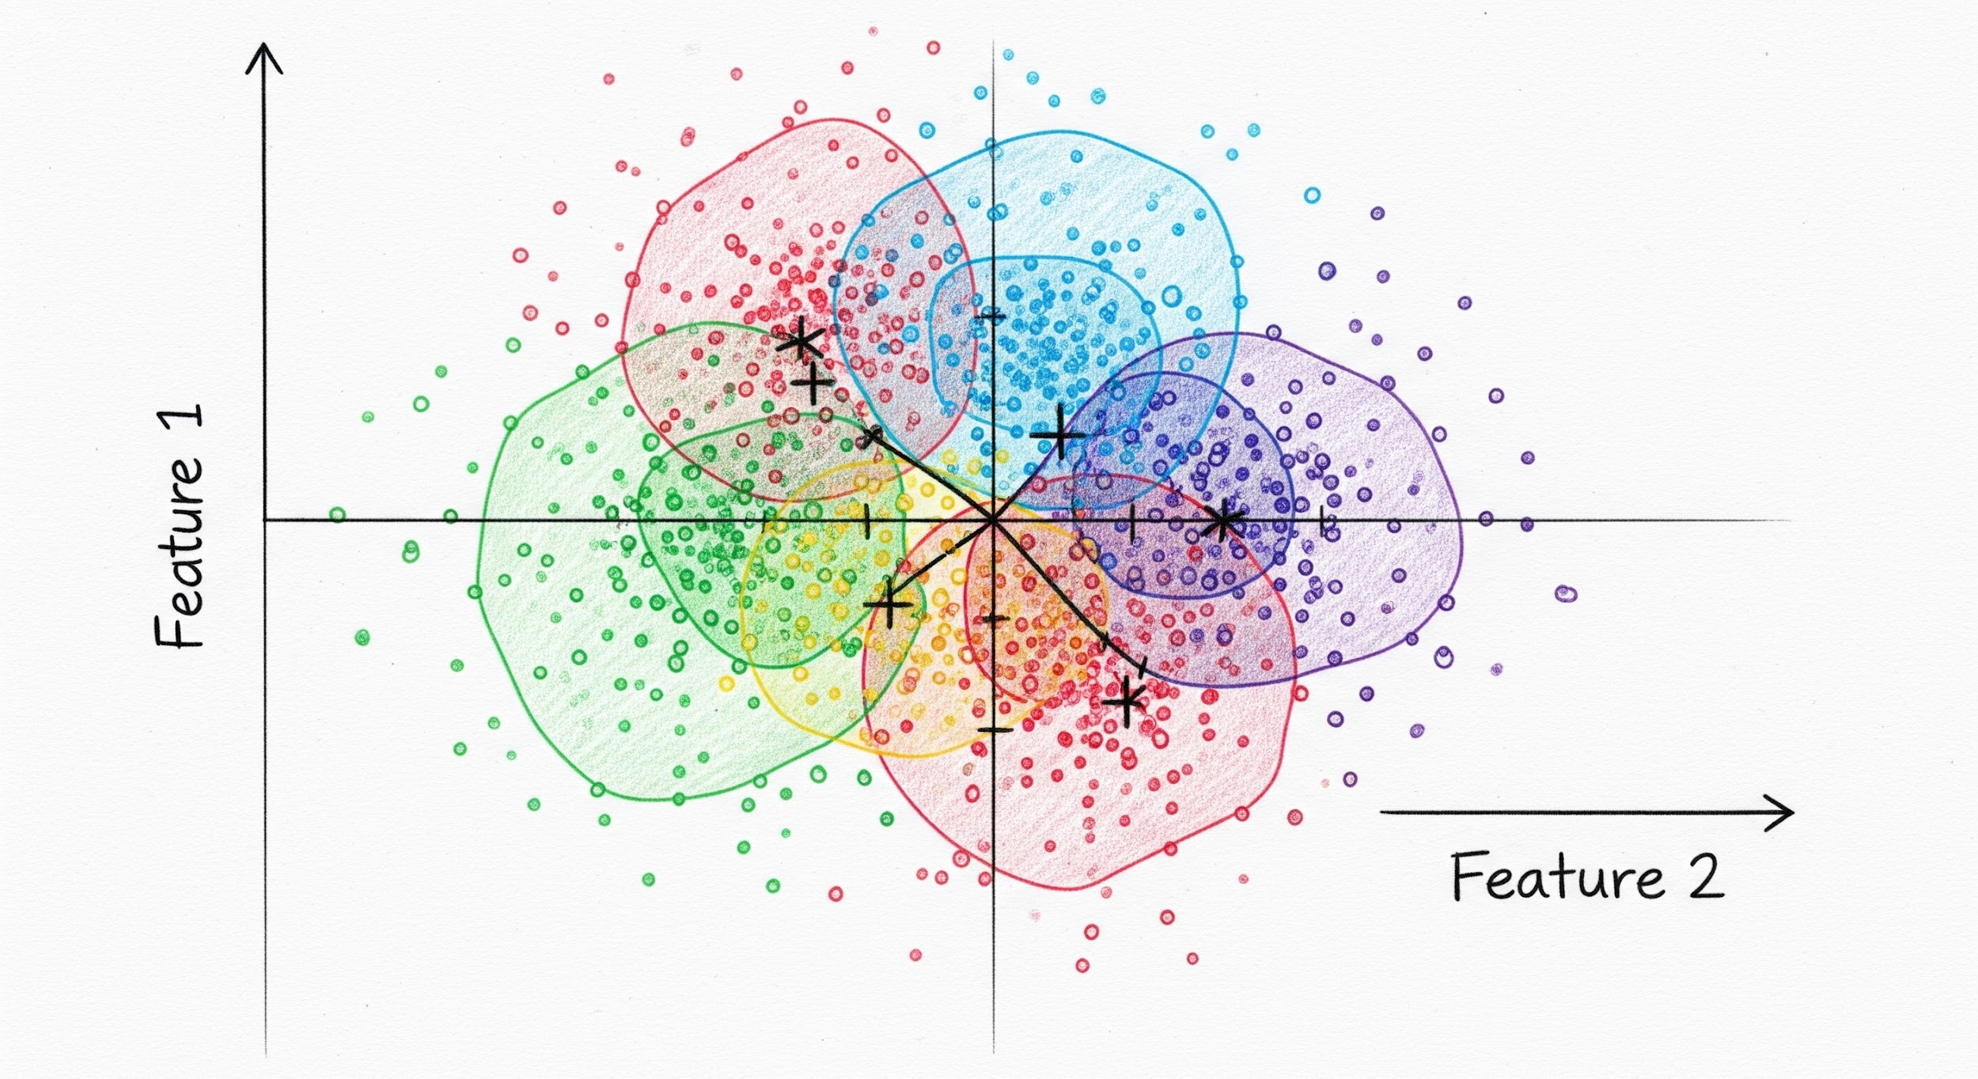
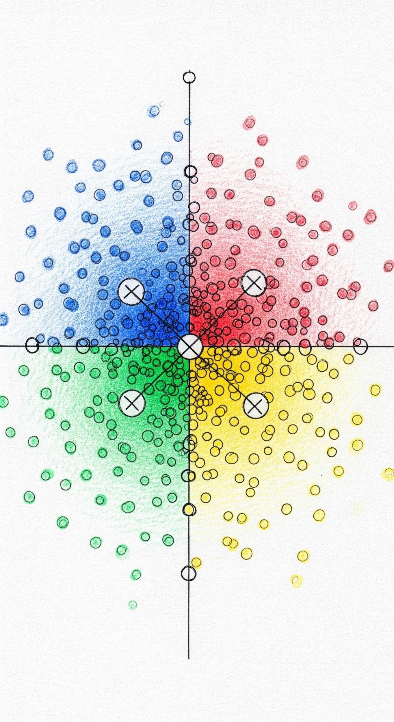
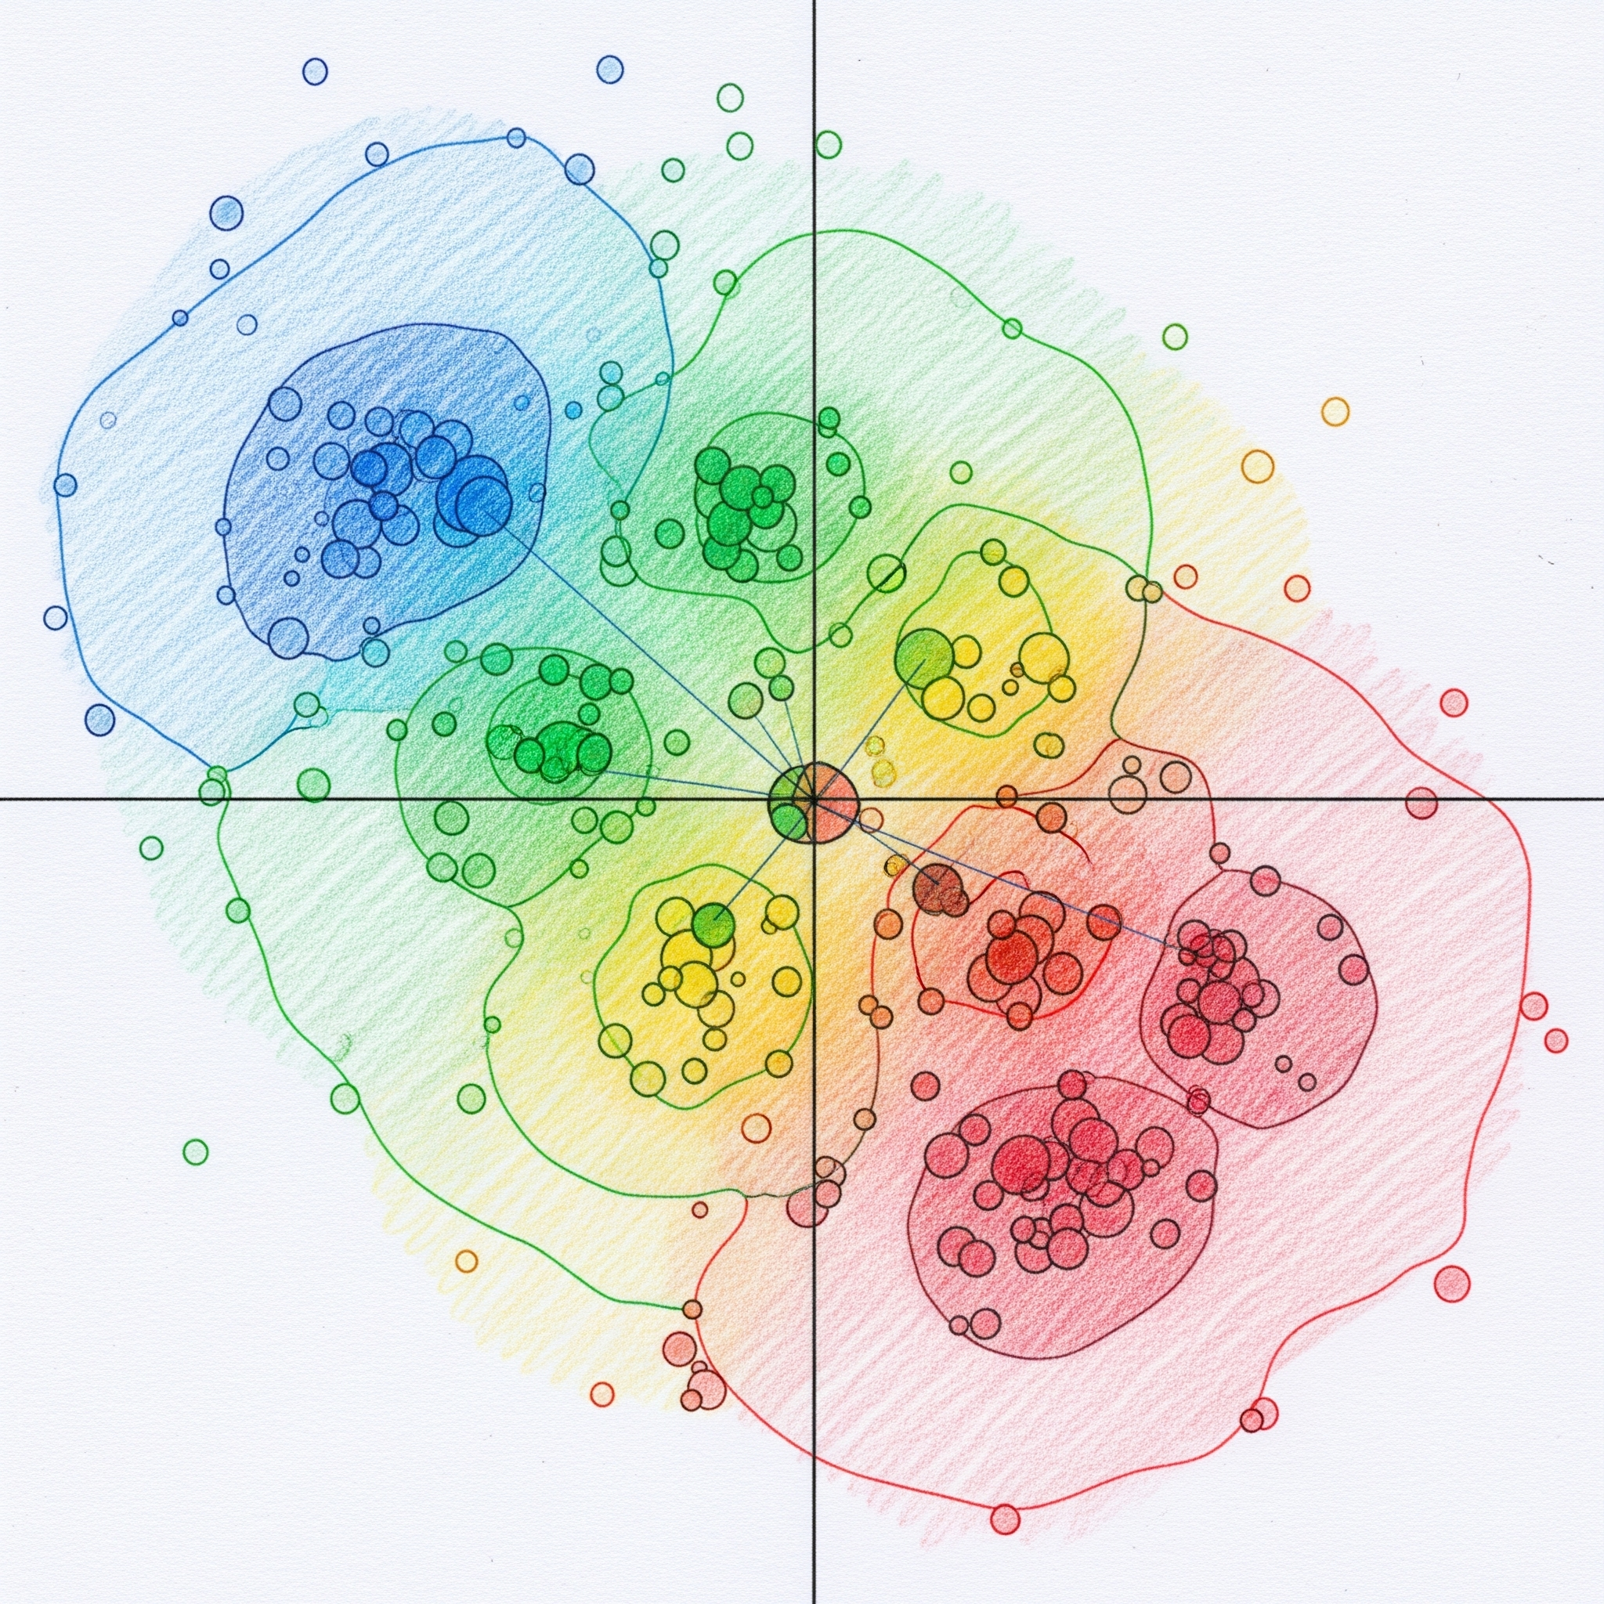
10/22/2025
Joel Martinez
Lunch & Learn:
Segmentation

Slide 2

Segmentation
Grouping respondents based on similarity

Slide 3
Response Similarity
Algorithms
Metrics
Data
Different algorithms calculate similarity differently
Different metrics capture different dimensions of similarity
Data format and type can change degree & meaning of similarity
K means
Centroid + spherical distance
Hierarchical clustering
Pairwise similarity
DBSCAN
Neighbor + density similarity
Spectral Clustering
Graph kernel
Mixture Models
Probablistic
Latent Class Analysis
Probablistic
Magnitude Similarity
Euclidean
Jaccard
Manhattan
Pattern Similarity
Correlation
Cosine
Euclidean
Jaccard
Continuous
vs.
Categorical
Raw data
vs
Similarity Matrix
These analytic decisions affect the cluster results you get!

Slide 4
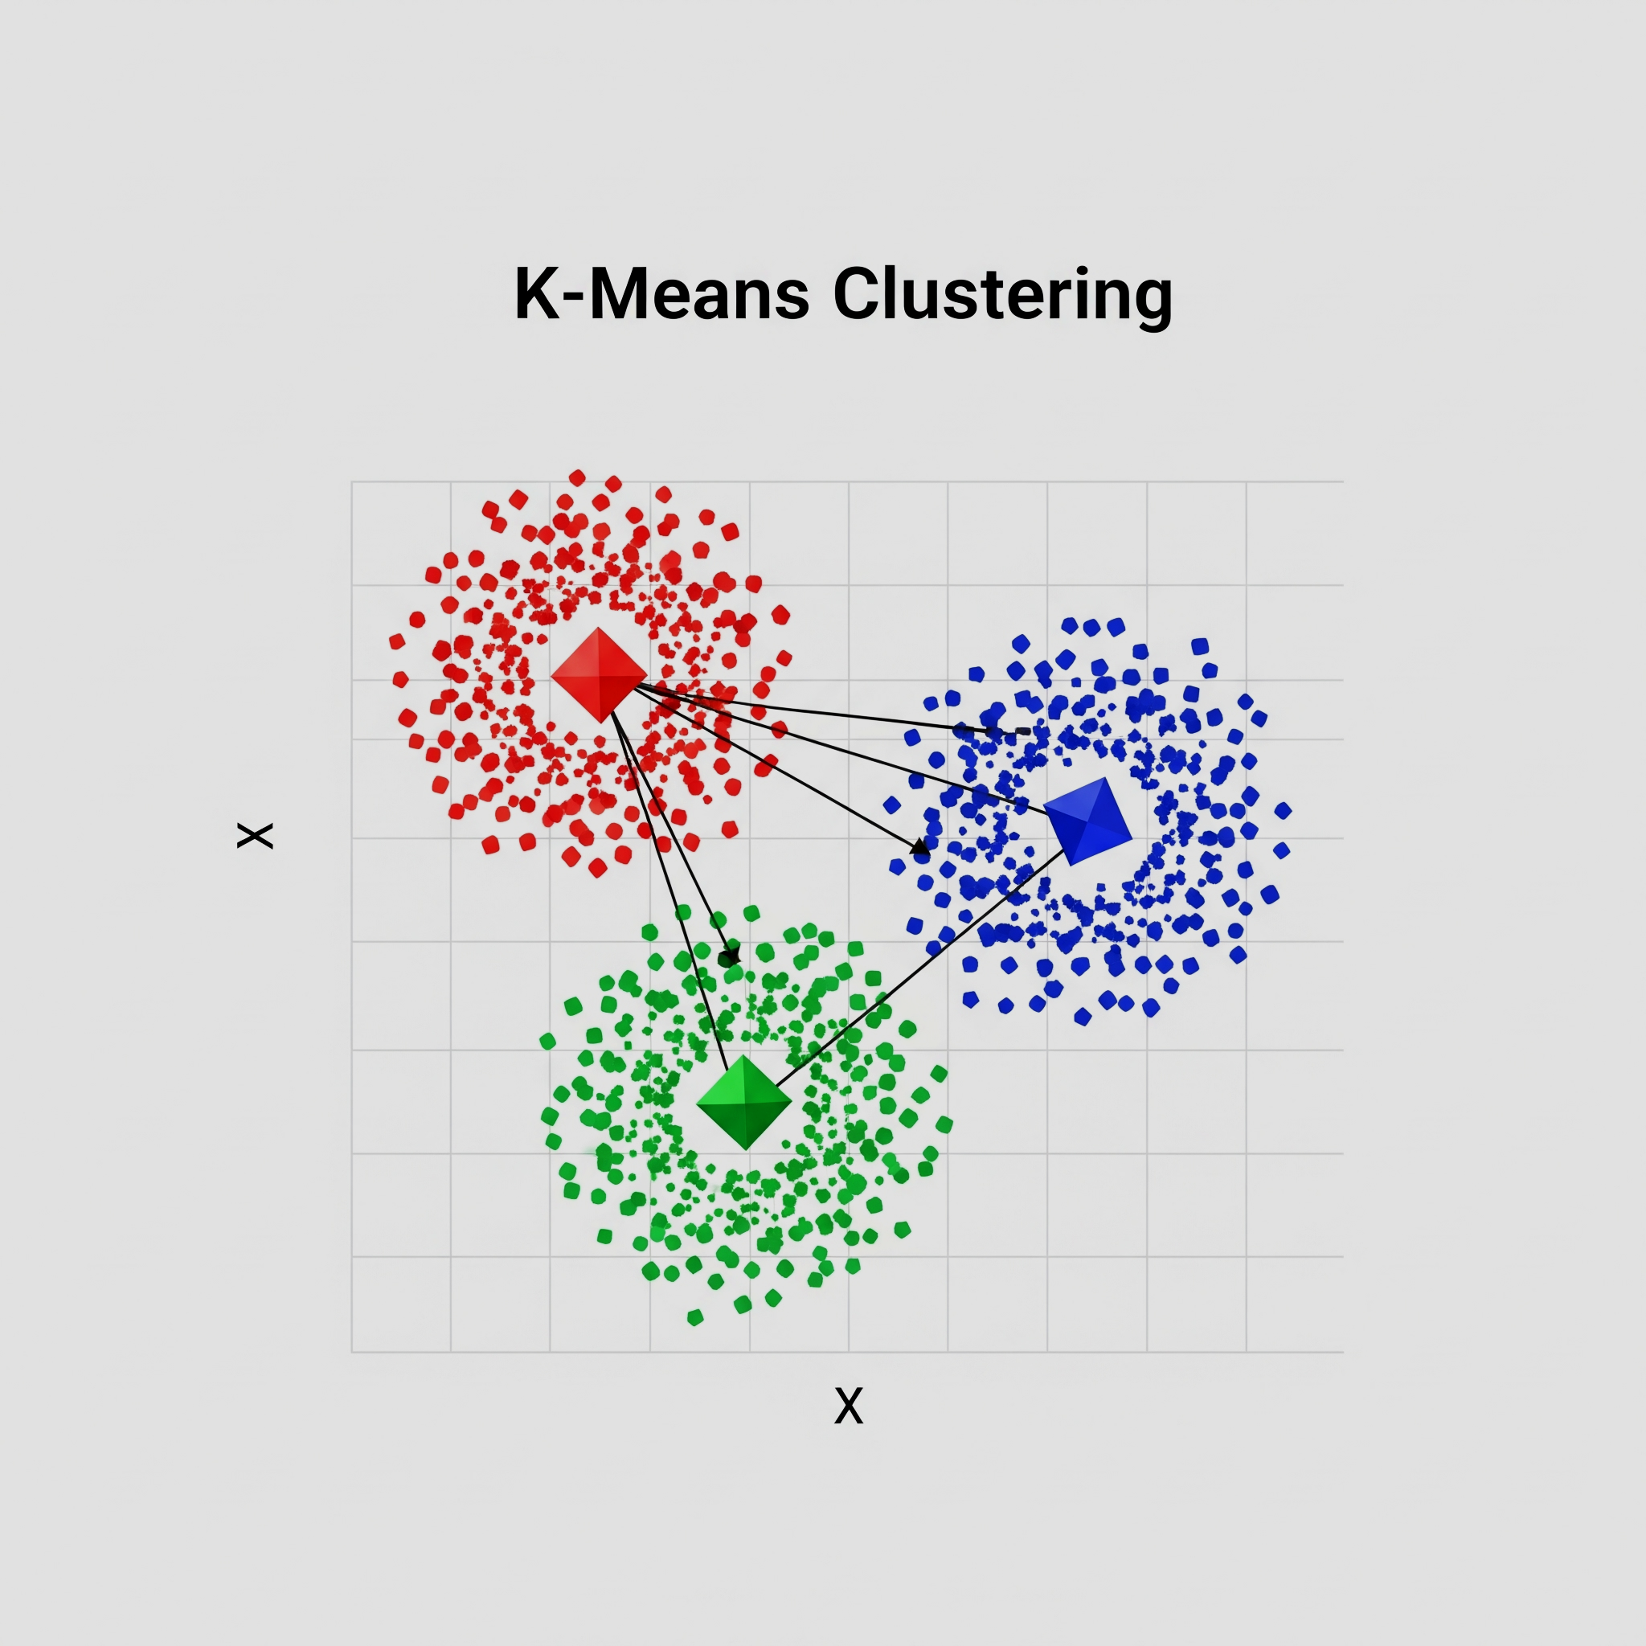
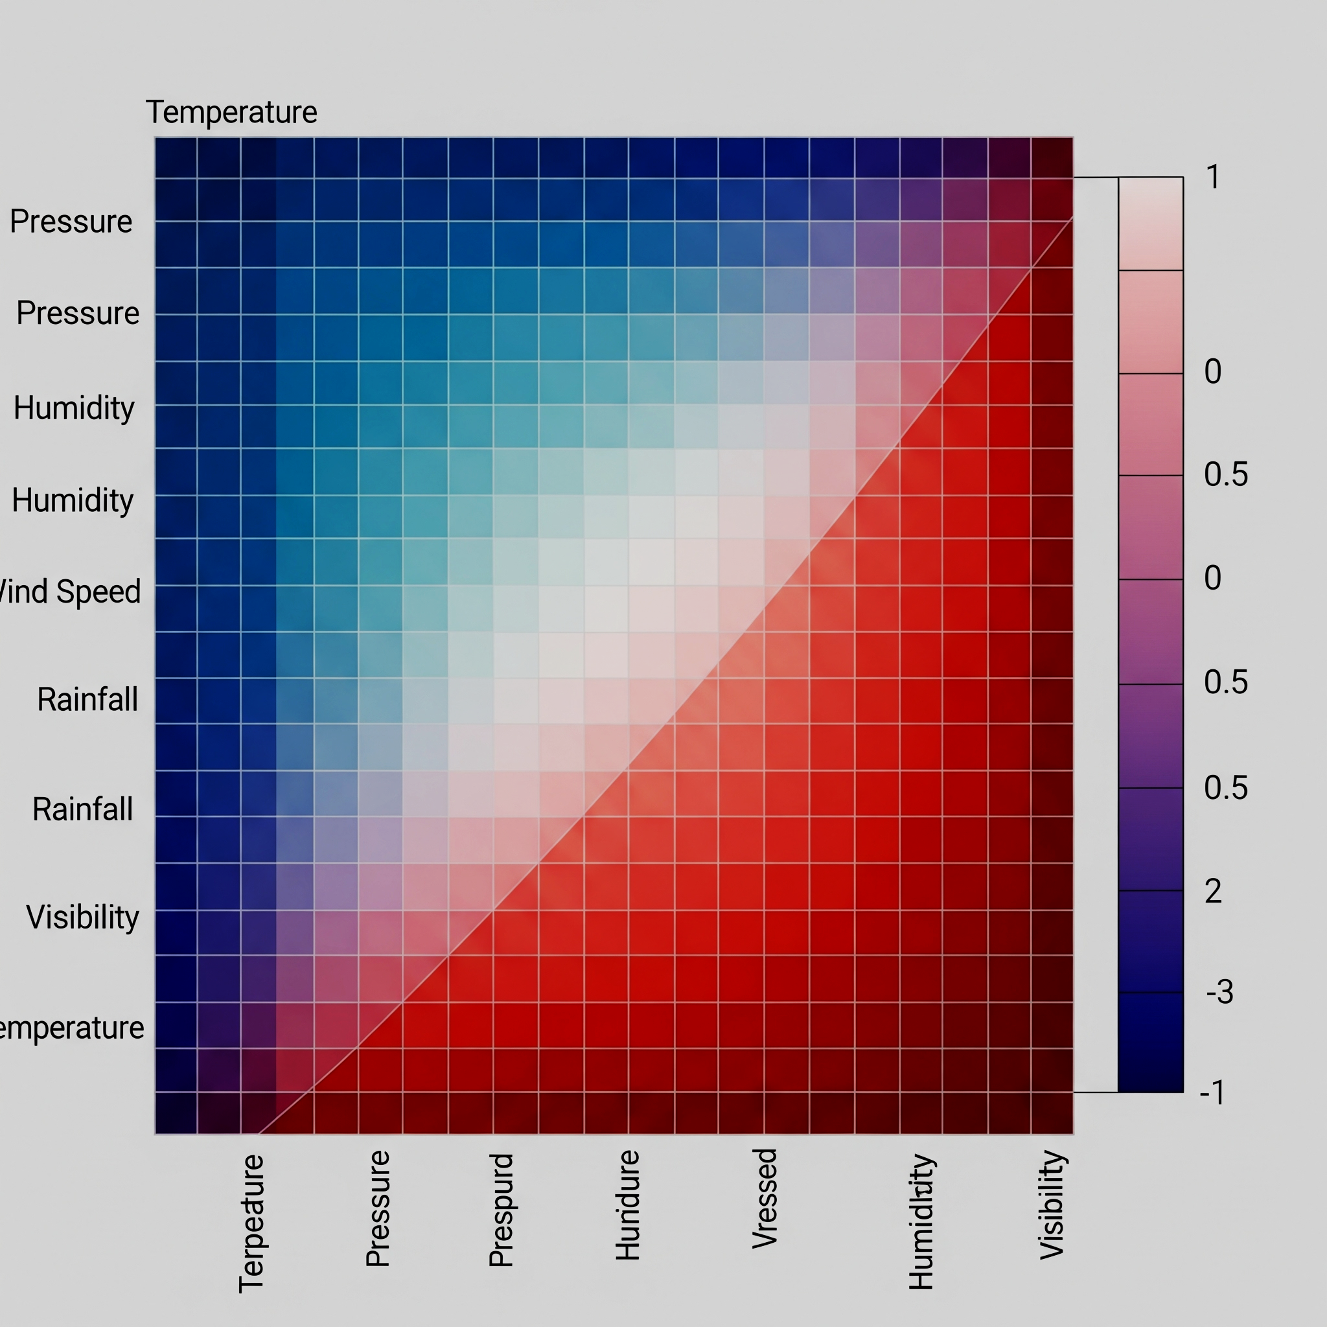
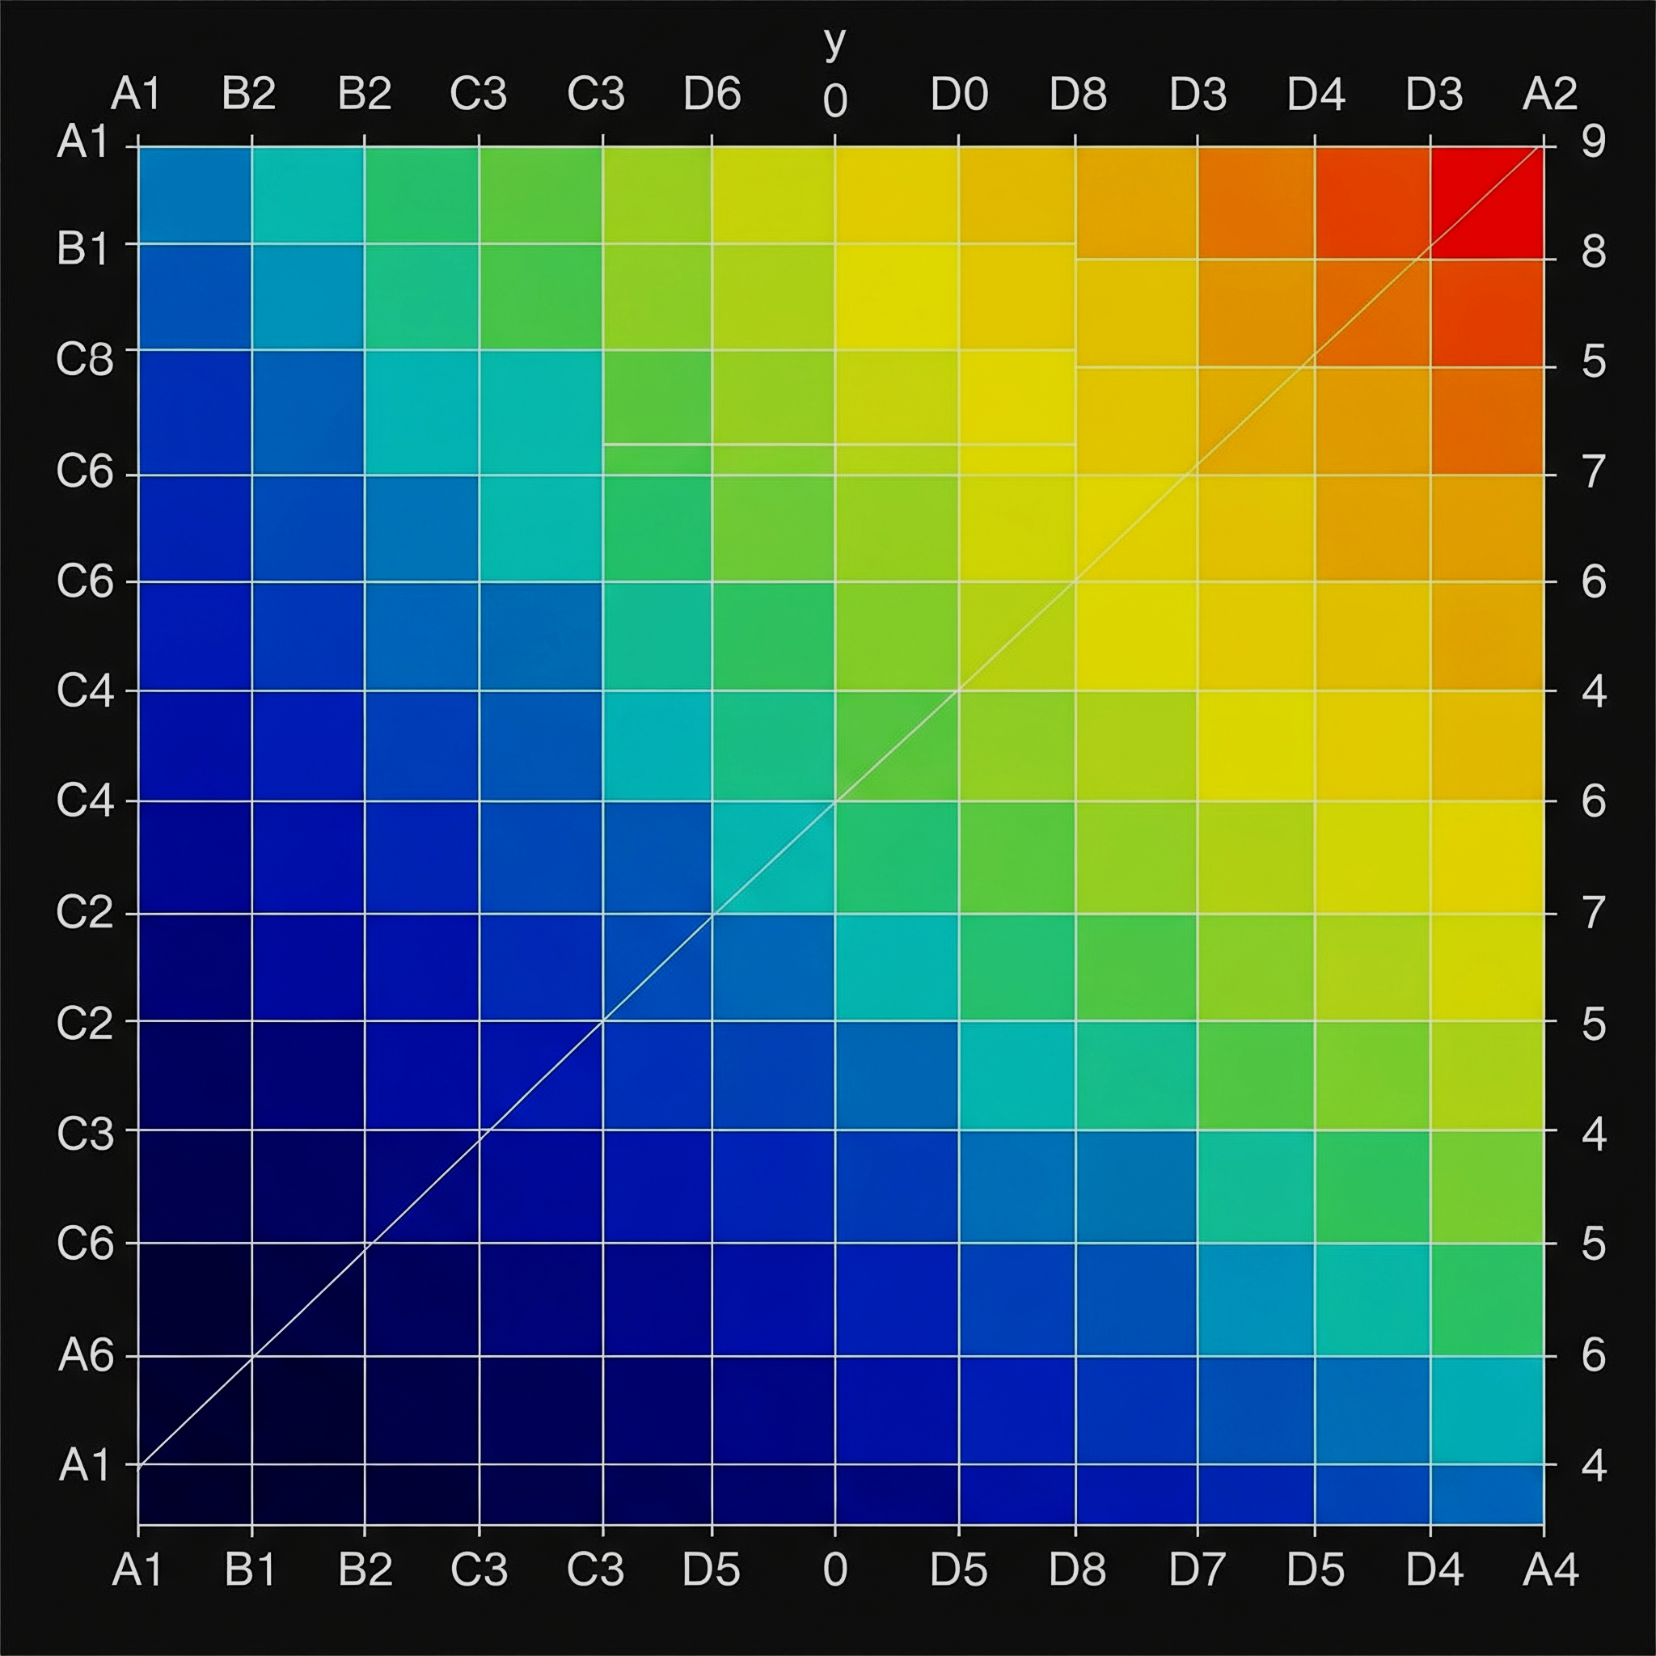
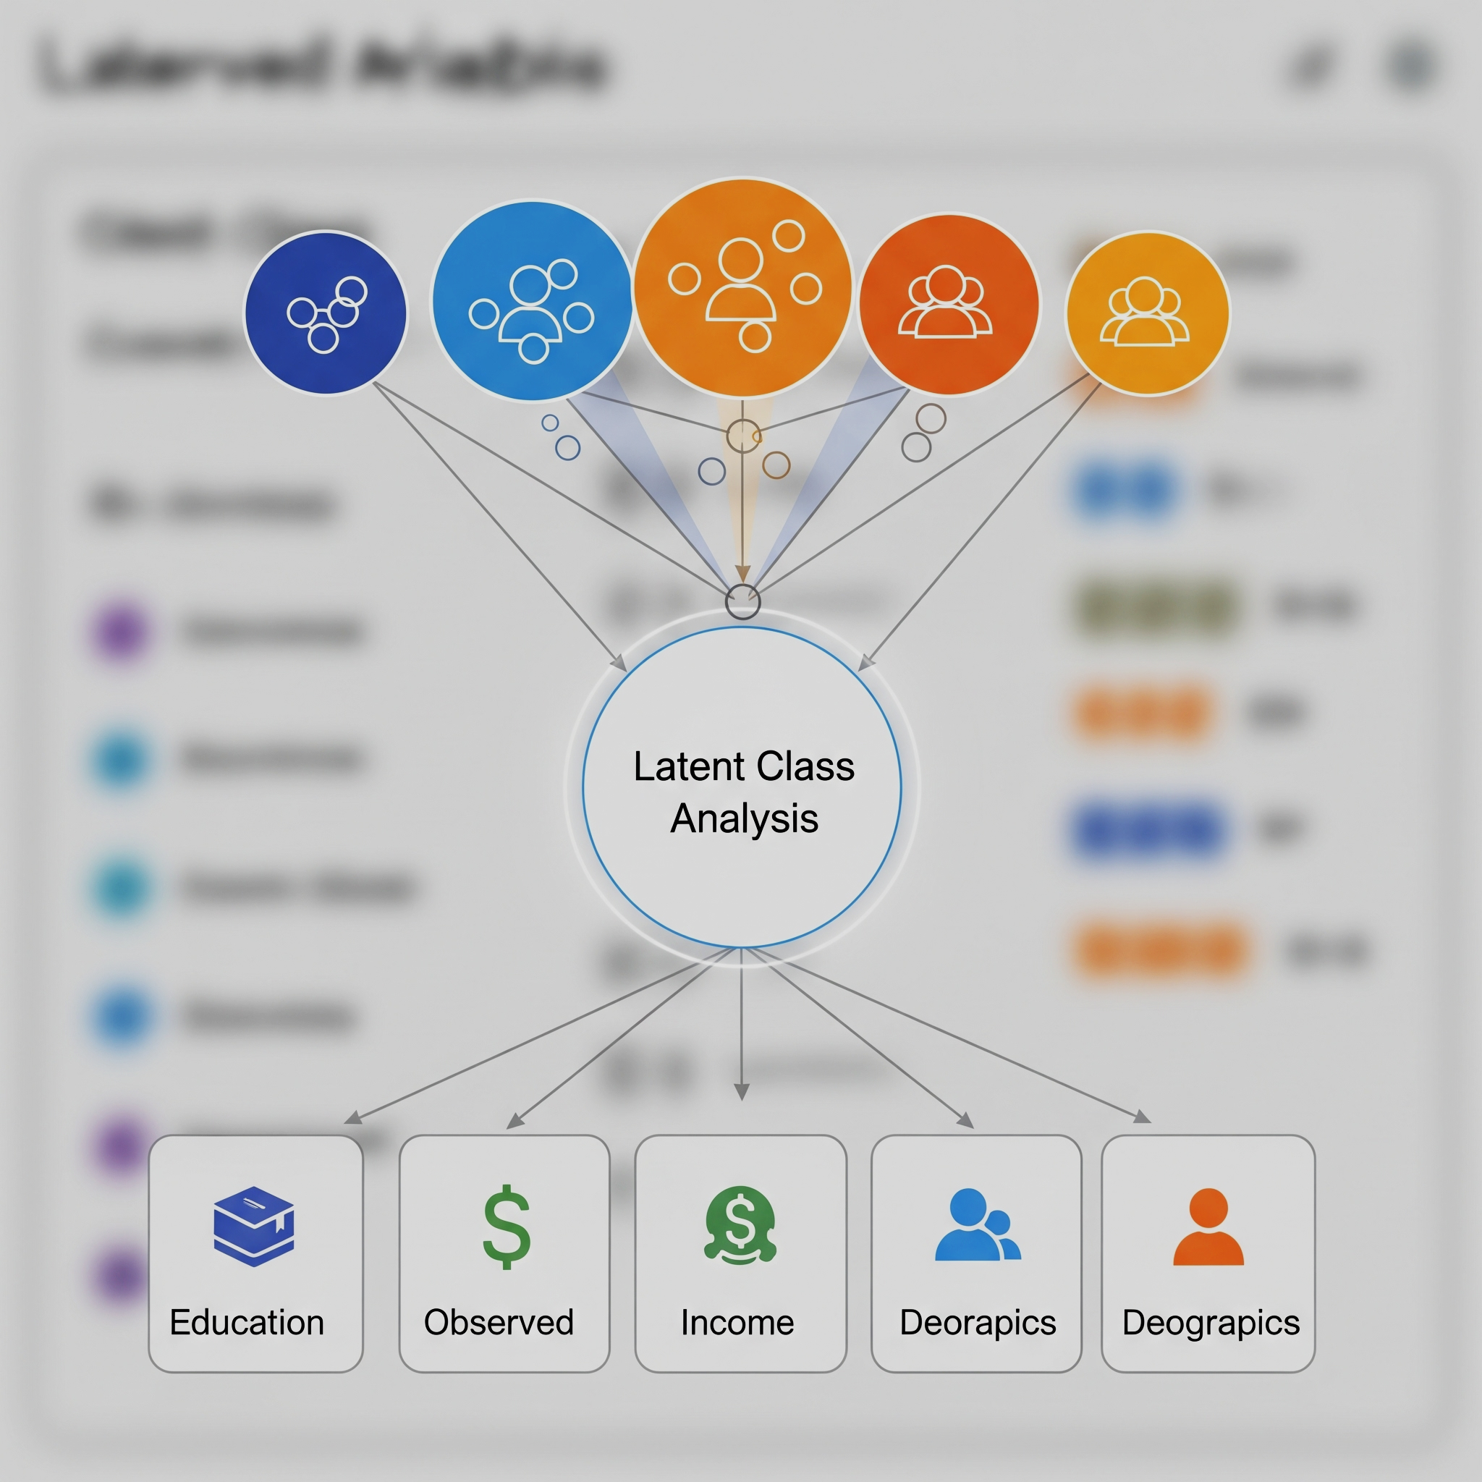
Comparisons
1.
2.
3.
4.
K Means +
Raw Data
K Means + Correlation Similarity Matrix
K Means +
Jaccard Similarity Matrix
Latent Class Analysis +
Raw Data

Slide 5
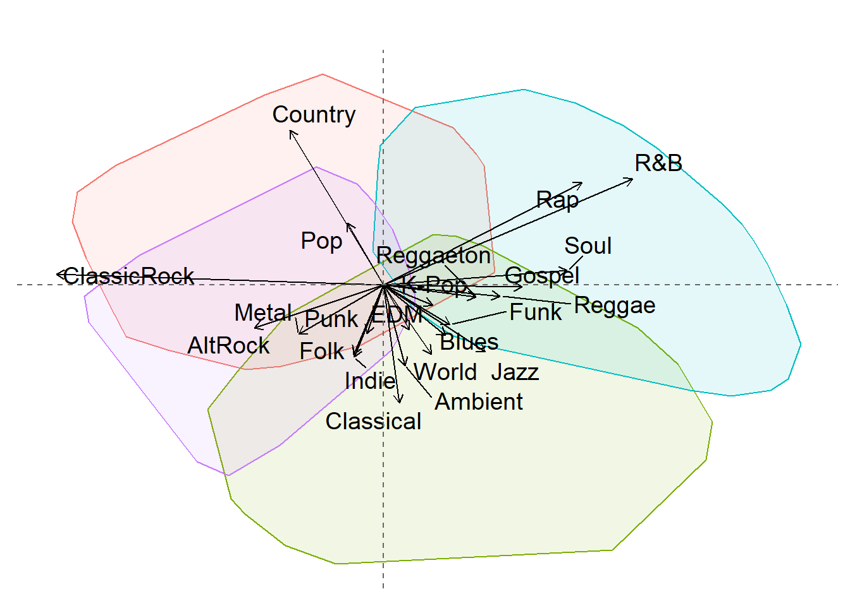
Dataset: Genre Preferences
How do music clusters change?
Data: 22 genres, multi-select, exclude “none of the above”
For all analyses, I ran a 4 cluster solution but changed the data preprocessing or the algorithm.

Slide 6
K Means + Raw Data
‹#›
Raw Data
Person | AltRock | Ambient | Blues | ClassicRock | …
A | 0 | 1 | 0 | 1 | …
B | 1 | 1 | 1 | 1 | …
C | 0 | 1 | 1 | 0 | …
Profile
Cluster Assignment
K Means K = 4; Euclidean Distance
Principal Component Analysis (PCA)
[0: Not Selected] [1: Selected]
Biplot Visualization

Slide 7
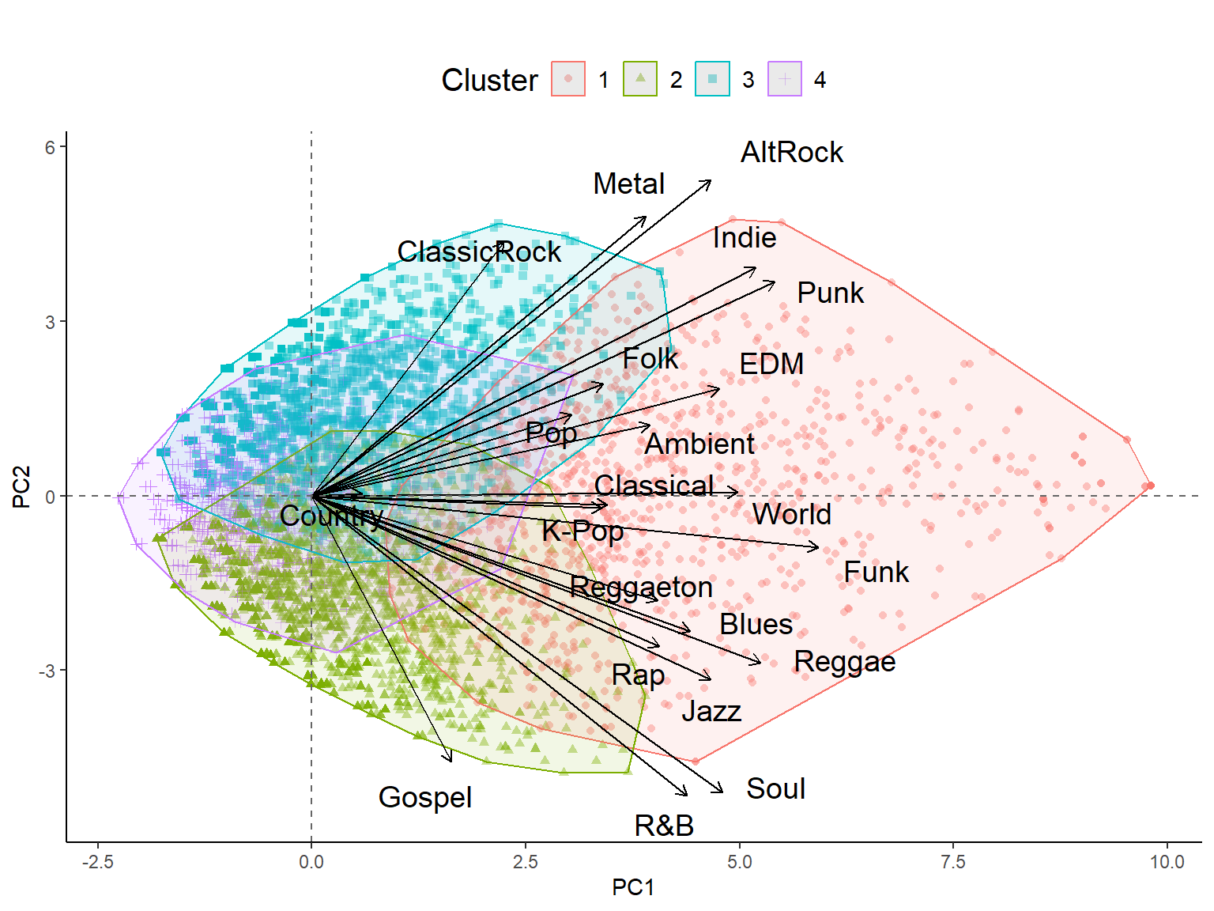
‹#›
Americana
Selects
Less Genres
Musical Heritage
Selects More Genres
Afro-Diasporic
Magnitude

Slide 8
‹#›
Americana
Cluster 1: Most interested (generalists)
Cluster 2: Prefer Afro-Diasporic
Selects
Less Genres
Musical Heritage
Selects More Genres
Cluster 3: Prefer Americana
Afro-Diasporic
Cluster 4: Least Interested (picky)
Magnitude

Slide 9
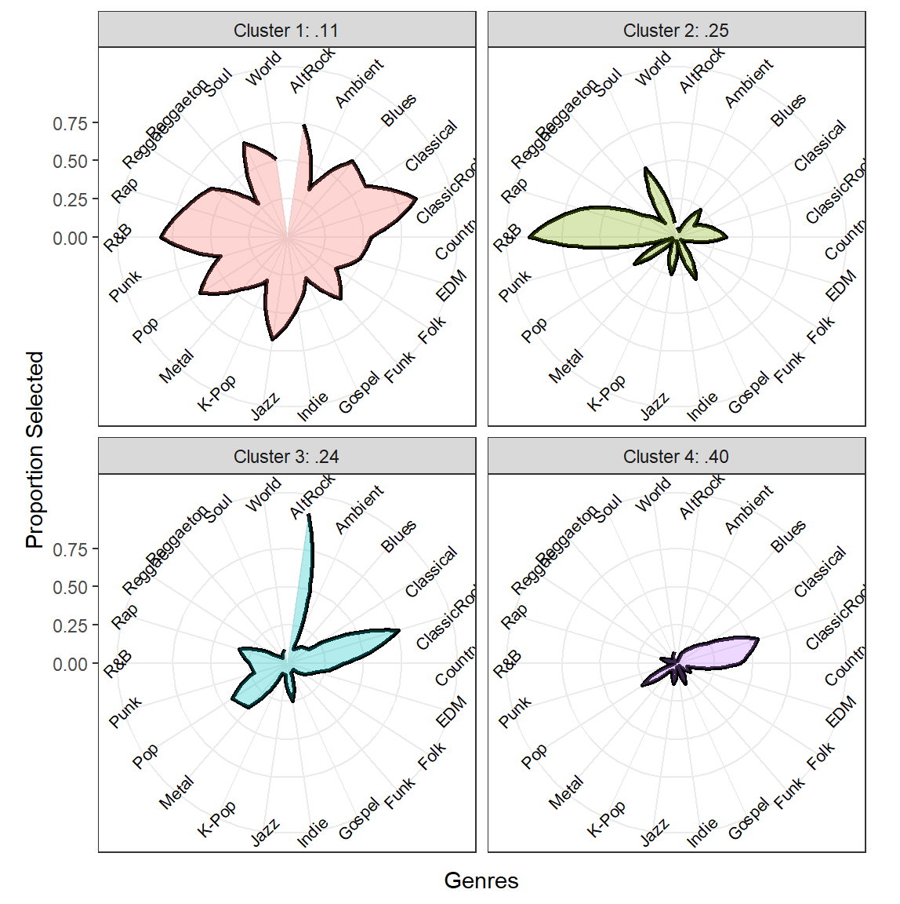
‹#›
Cluster 1: Most interested (generalists)
Cluster 2: Prefer Afro-Diasporic
Cluster 3: Prefer Americana
Cluster 4: Least Interested (picky)

Slide 10
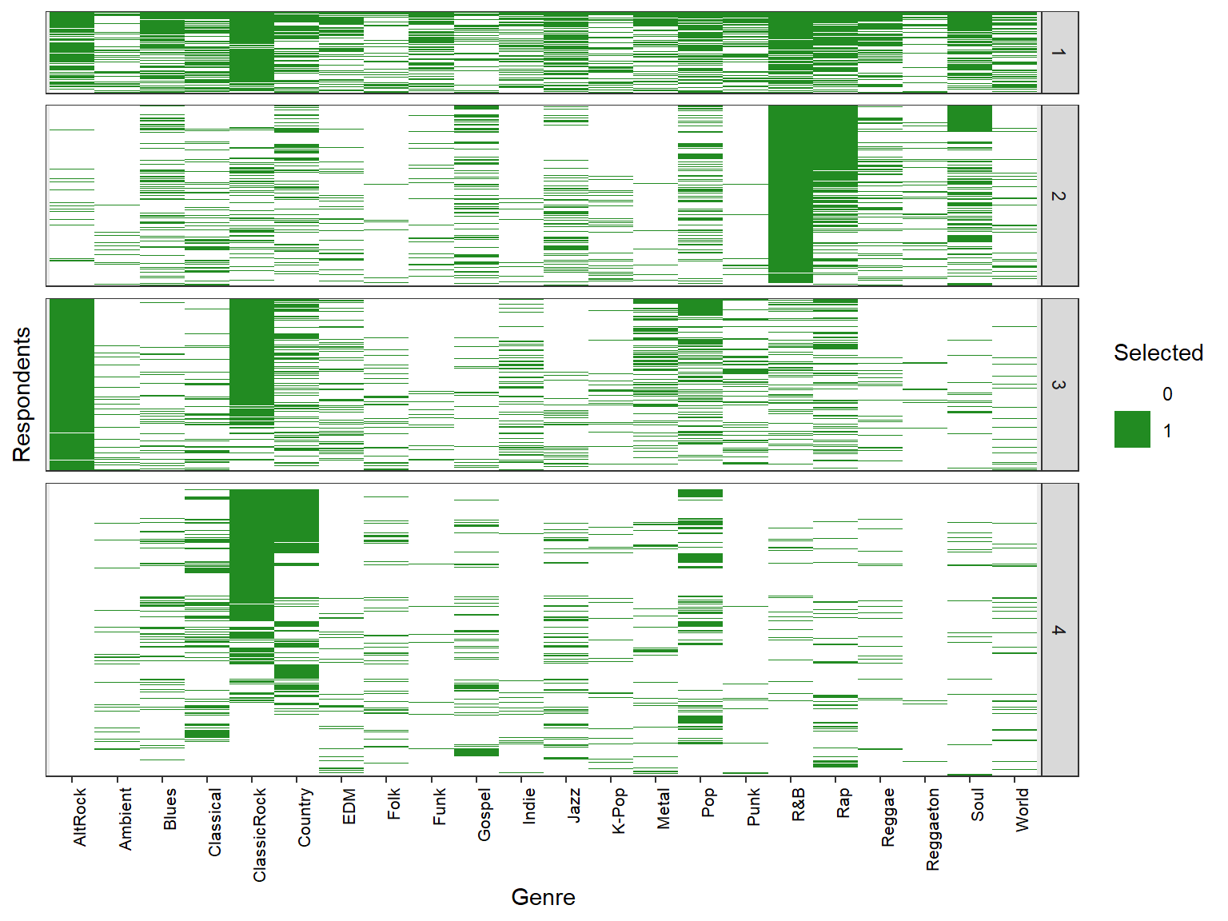
‹#›
Cluster 1: Most interested (generalists)
Cluster 2: Prefer Afro-Diasporic
Cluster 3: Prefer Americana
Cluster 4: Least Interested (picky)

Slide 11
K Means + Correlation Matrix
‹#›
Raw Data
Profile
Person | AltRock | Ambient | Blues | ClassicRock
A | 0 | 1 | 0 | 1
B | 1 | 1 | 1 | 0
C | 0 | 1 | 1 | 0
Cluster Assignment
Correlation Matrix
K Means K = 4; Euclidean Distance
A B C
1 | .4 | .2
.4 | 1 | .3
.2 | .3 | 1
C B A
Principal Component Analysis (PCA)
[0: Not Selected] [1: Selected]
Biplot Visualization

Slide 12
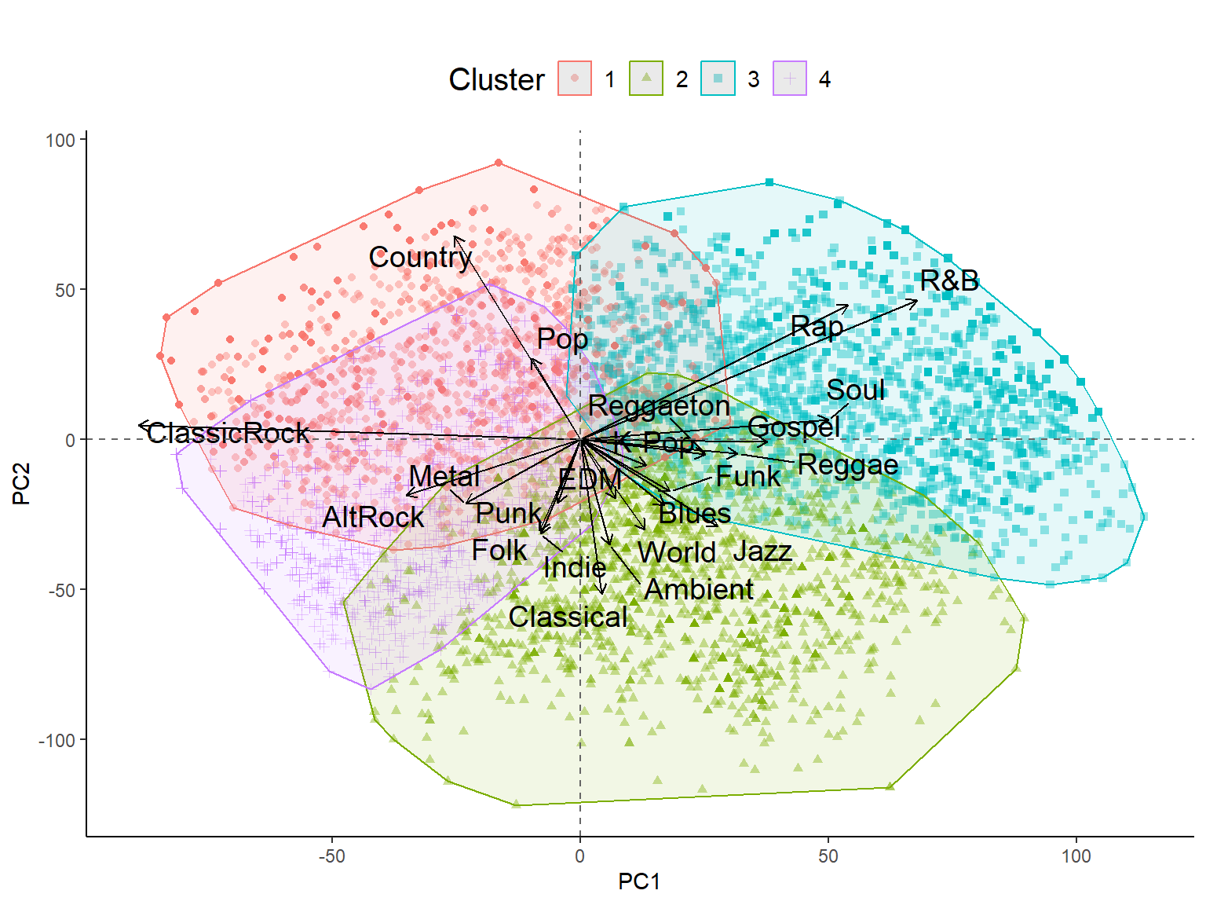
‹#›
Mainstream
Cluster 1: Mainstream Americana
Americana
Cluster 2: Eclectic
Popularity
Afro-Diasporic
Cluster 3: Mainstream Afro-Diasporic
Eclectic
Cluster 4: Eclectic Americana
Musical Heritage

Slide 13
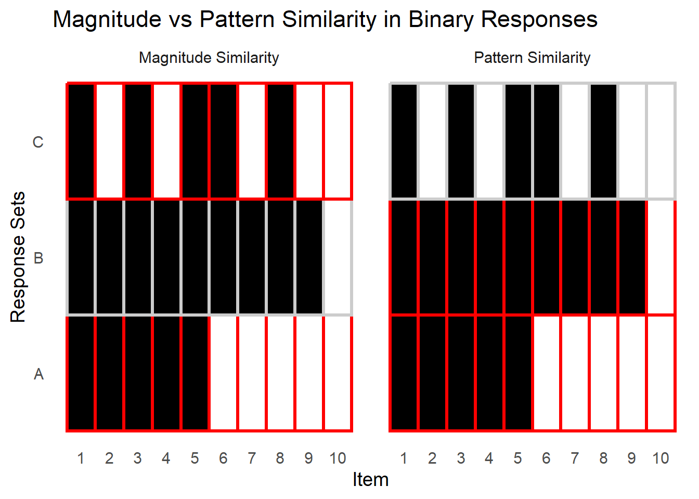
Magnitude vs. Pattern
‹#›

Slide 14
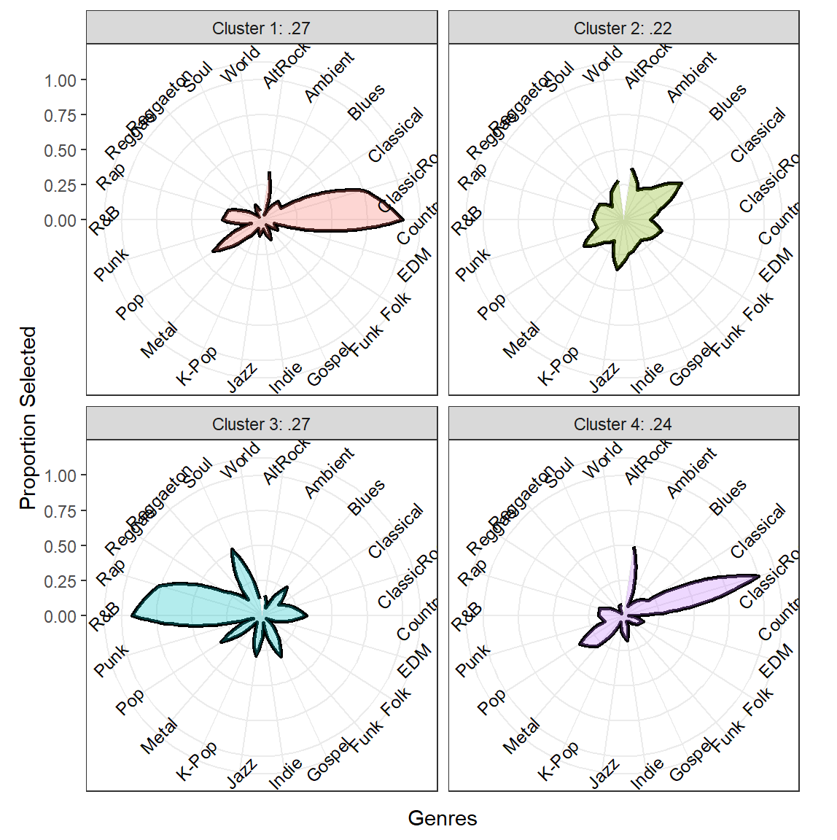
‹#›
Cluster 1: Mainstream Americana
Cluster 2: Eclectic
Cluster 3: Mainstream Afro-Diasporic
Cluster 4: Eclectic Americana

Slide 15
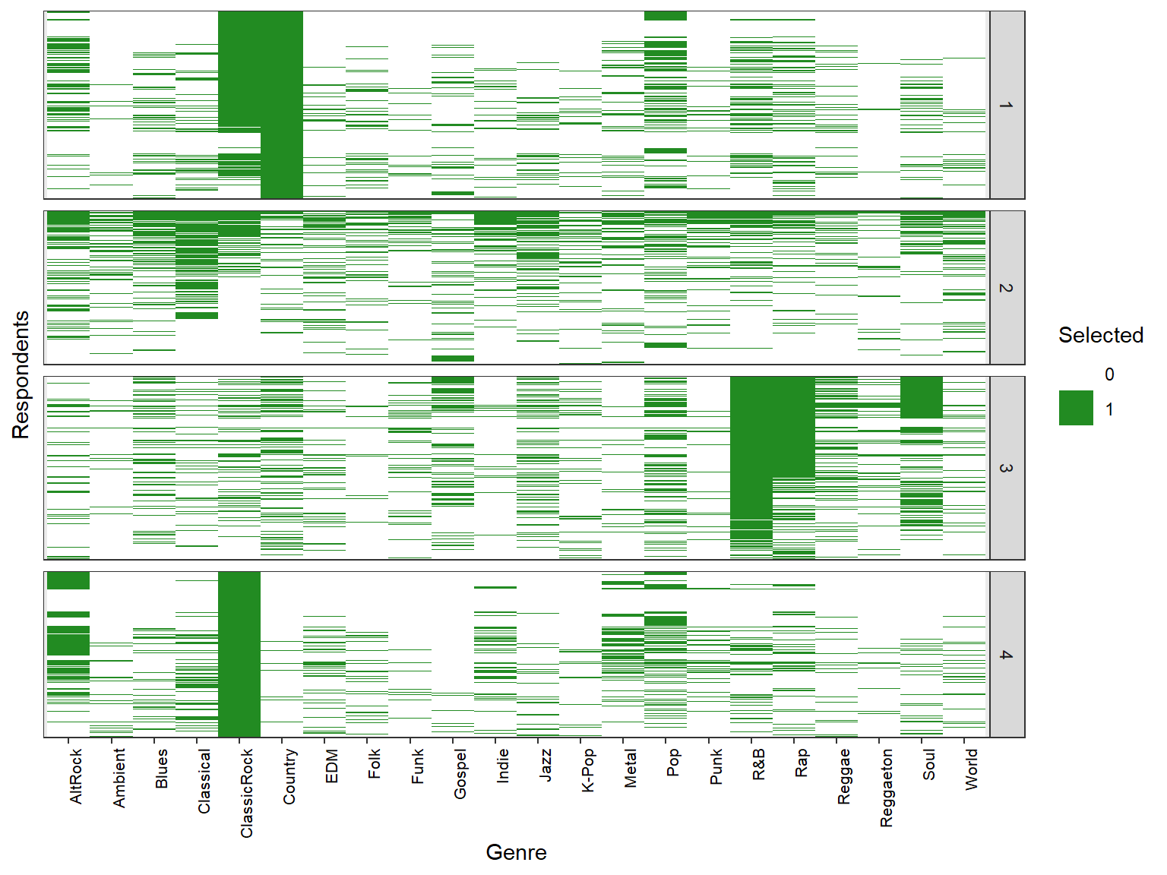
‹#›
Cluster 1: Mainstream Americana
Cluster 2: Eclectic
Cluster 3: Mainstream Afro-Diasporic
Cluster 4: Eclectic Americana

Slide 16
K Means + Jaccard Matrix
‹#›
Raw Data
Profile
Person | AltRock | Ambient | Blues | ClassicRock
A | 0 | 1 | 0 | 1
B | 1 | 1 | 1 | 0
C | 0 | 1 | 1 | 0
Jaccard
Similarity Matrix
Cluster Assignment
K Means K = 4; Euclidean Distance
A B C
1 | .4 | .2
.4 | 1 | .3
.2 | .3 | 1
C B A
Principal Component Analysis (PCA)
[0: Not Selected] [1: Selected]
Biplot Visualization

Slide 17
Jaccard Similarity
‹#›
Lower Similarity
Higher Similarity
0 | 1 | 0 | 1
1 | 1 | 1 | 0
0 | 1 | 0 | 1
1 | 1 | 0 | 1
1 Match
4 Total (where 1)
Similarity = .25
2 Match
3 Total (where 1)
Similarity = .67
Shared absence (0) is not treated as meaningful overlap Only accounts for where interest (1) is shown by at least one person
Correlation & Euclidean do consider shared 0’s as meaningful

Slide 18
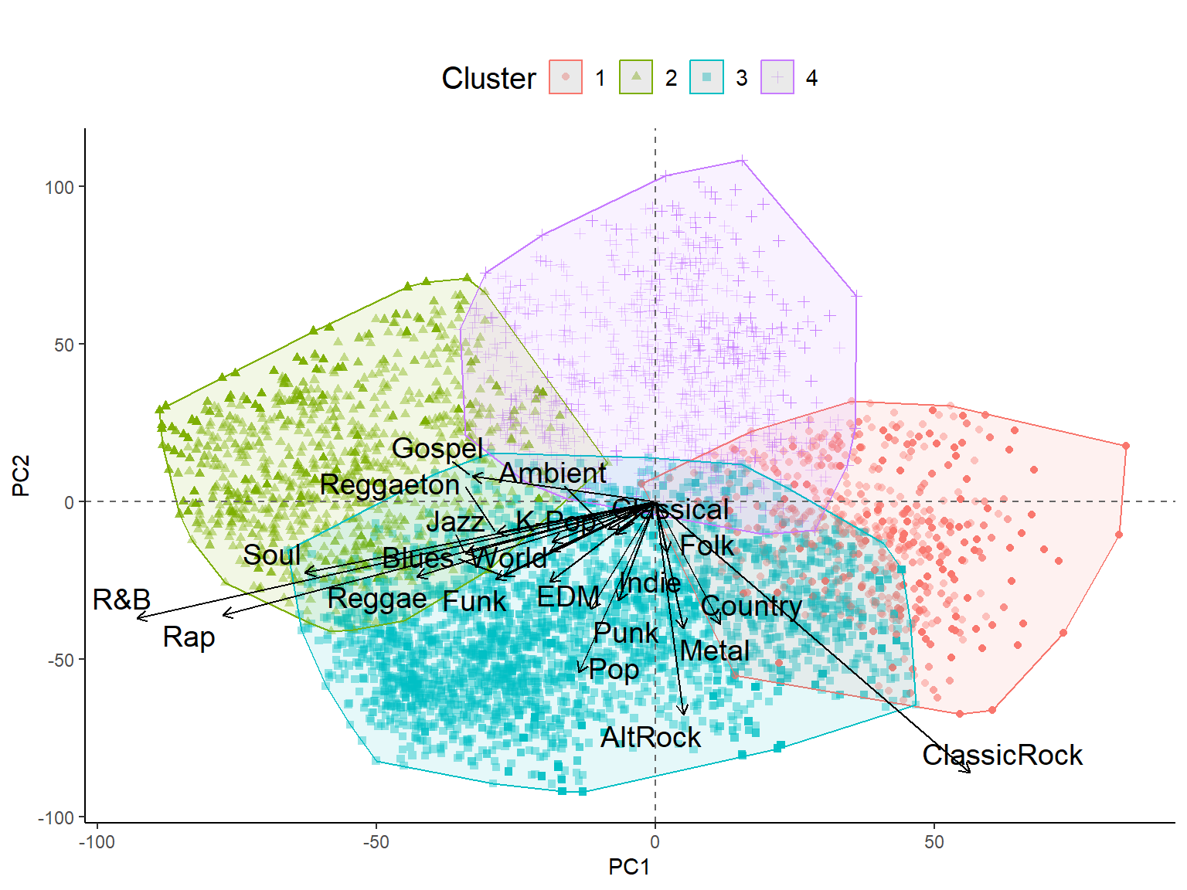
‹#›
Less Interest
Cluster 1: Prefers Americana
Afro-Diasporic
Eclectic
Cluster 2: Prefers Afro-Diasporic
Magnitude
Americana
Cluster 3: Most interested
More interest
Cluster 4: Least interested
Mainstream
Musical Heritage

Slide 19
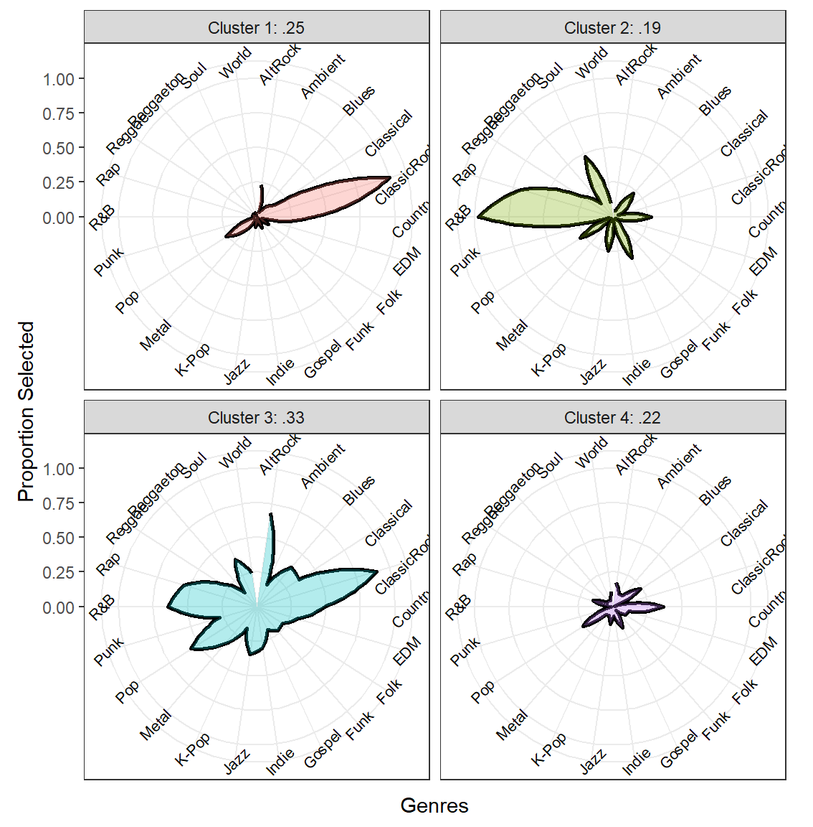
‹#›
Cluster 1: Prefers Americana
Cluster 2: Prefers Afro-Diasporic
Cluster 3: Most interested
Cluster 4: Least interested

Slide 20
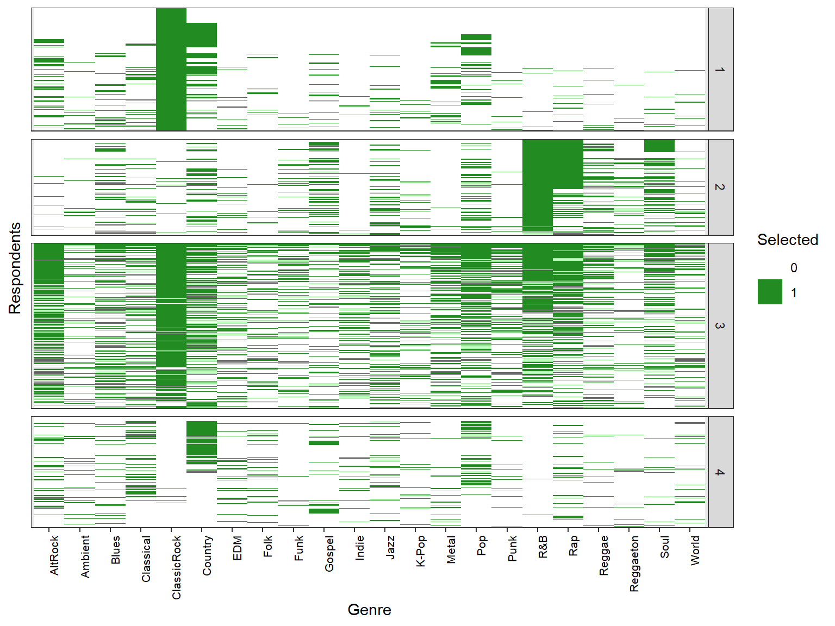
‹#›
Cluster 1: Prefers Americana
Cluster 2: Prefers Afro-Diasporic
Cluster 3: Most interested
Cluster 4: Least interested
Notes:
That it treats shared absence as not meaningful is why taste is magnified (if only choose 1 genre and others choose only that 1 genre, that is a similarity of 1).

Slide 21
LCA + Raw Data
‹#›
Raw Data
Person | AltRock | Ambient | Blues | ClassicRock | …
A | 0 | 1 | 0 | 1 | …
B | 1 | 1 | 1 | 1 | …
C | 0 | 1 | 1 | 0 | …
Profile
Cluster Assignment
Latent Class Analysis
K = 4; Probabilistic
Principal Component Analysis (PCA)
[0: Not Selected] [1: Selected]
Biplot Visualization

Slide 22
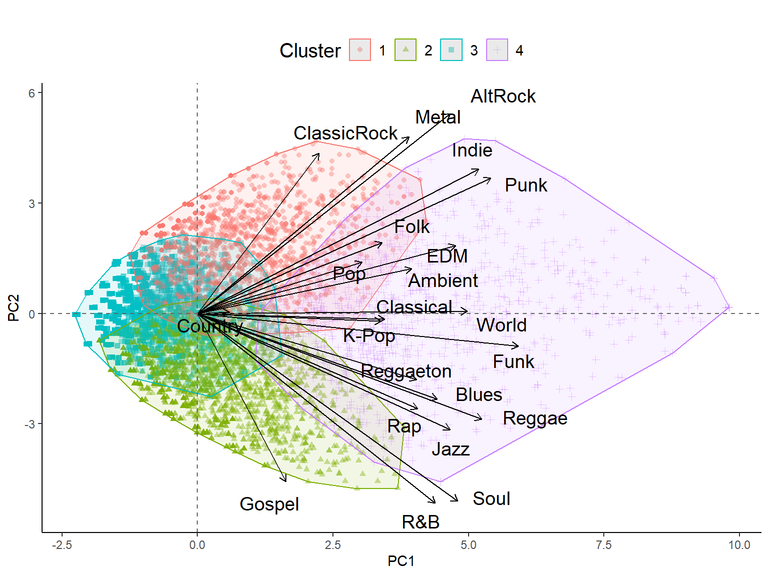
‹#›
Americana
Cluster 1: Prefer Americana
Cluster 2: Prefer Afro-Diasporic
Selects
Less Genres
Musical Heritage
Selects More Genres
Cluster 3:
Least Interested (picky)
Afro-Diasporic
Cluster 4:
Most interested (generalists)
Magnitude

Slide 23
K Means results again
‹#›
Americana
Cluster 1: Most interested (generalists)
Cluster 2: Prefer Afro-Diasporic
Selects
Less Genres
Musical Heritage
Selects More Genres
Cluster 3: Prefer Americana
Afro-Diasporic
Cluster 4: Least Interested (picky)
Magnitude

Slide 24
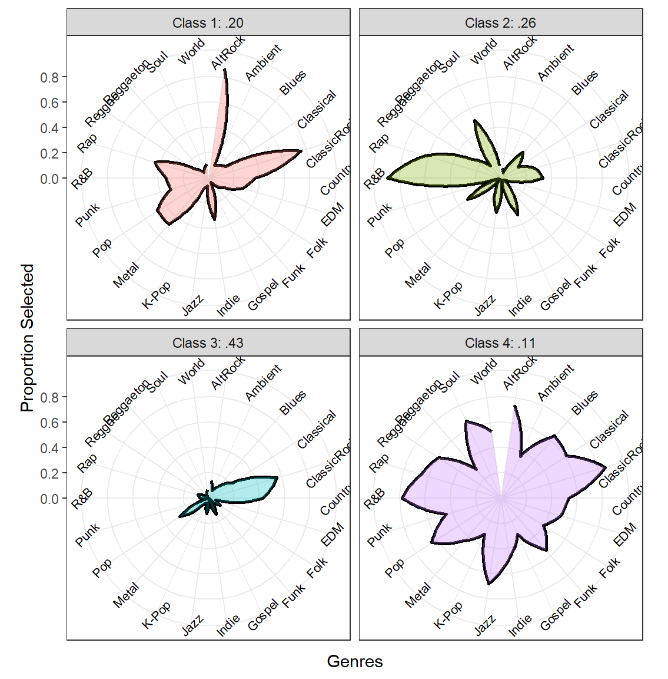
‹#›
Cluster 1: Prefer Americana
Cluster 2: Prefer Afro-Diasporic
Cluster 3:
Least Interested
Cluster 4:
Most interested (generalists)

Slide 25
Comparisons
1.
2.
3.
4.
K Means +
Raw Data
K Means + Correlation Similarity Matrix
K Means +
Jaccard Similarity Matrix
Latent Class Analysis +
Raw Data
What matters most to the project?
Captures Magnitude (PC1) and Main Taste (PC2)
Misses Nuance
Captures Main Taste (PC1) and Nuances (PC2)
Ignores Magnitude
Captures magnified Taste (PC1), Magnitude (PC2), and Nuances (harder to show)
Similar to K Means + Raw Data (for this dataset)
No forced classification (probabilities)

Slide 26
What matters?
Magnitude
Main Taste (diff)
Nuances
E.g., Maybe people who select a lot of genres have different attitudes and behavioral propensities related to a target outcome than those who choose less genres
These are typically the kind of clusters projects are looking to find, the most influential differentiations among people’s preferences
Maybe by disregarding magnitude (correlations) you identify less influential but still useful nuanced dimensions of taste (mainstream vs. eclectic)
LCA allows probabilistic assignment so you can examine cluster fuzziness (error)

Slide 27
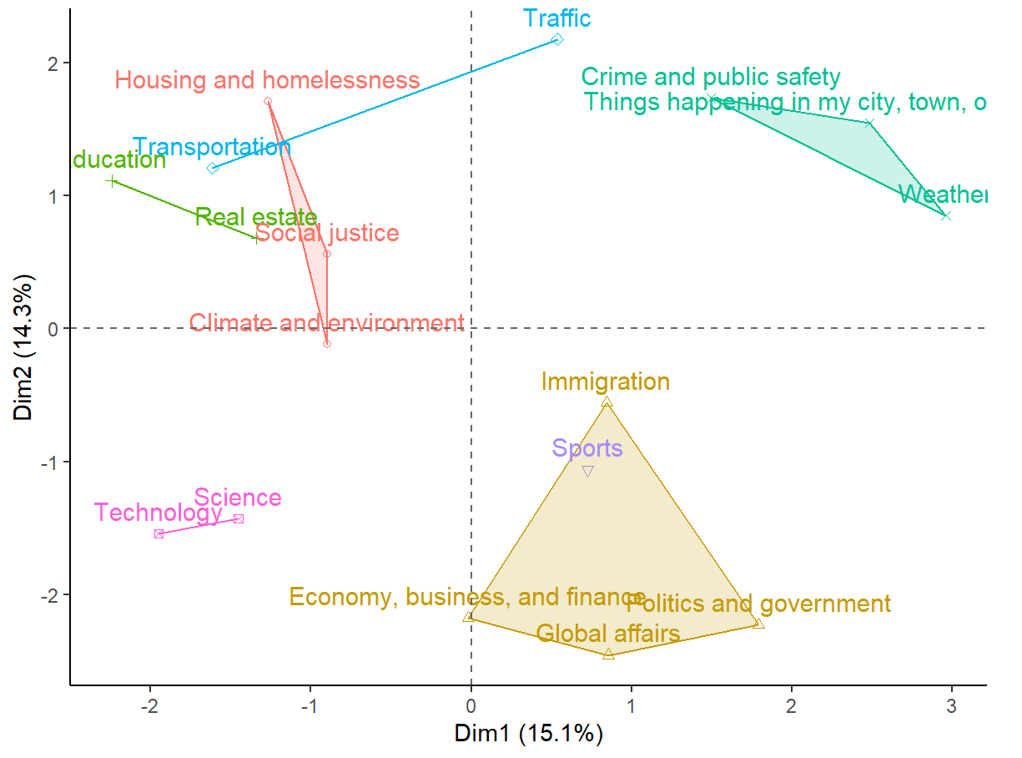
Item Segments: News Topics
‹#›
Local Scale
Broad/Systemic Issues
Civic Immediacy
Current Events
Large Scale

Slide 28
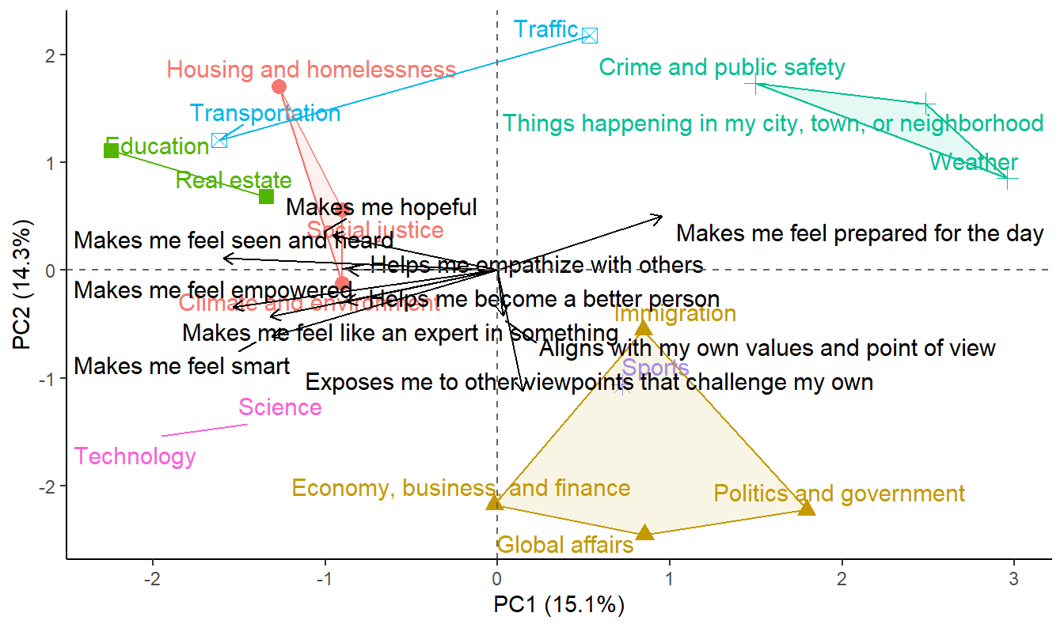
Topics x Gratifications
‹#›
Local Scale
Broad/Systemic Issues
Civic Immediacy
Current Events
Large Scale
Notes:
PC1 separates pragmatic, civic utility from self-expressive and growth-oriented uses of news.
Right: news as daily tool.
Left: news as personal enrichment or empowerment.
PC2 contrasts moral-intellectual engagement (bottom) with emotional or relational engagement (top).

Slide 29
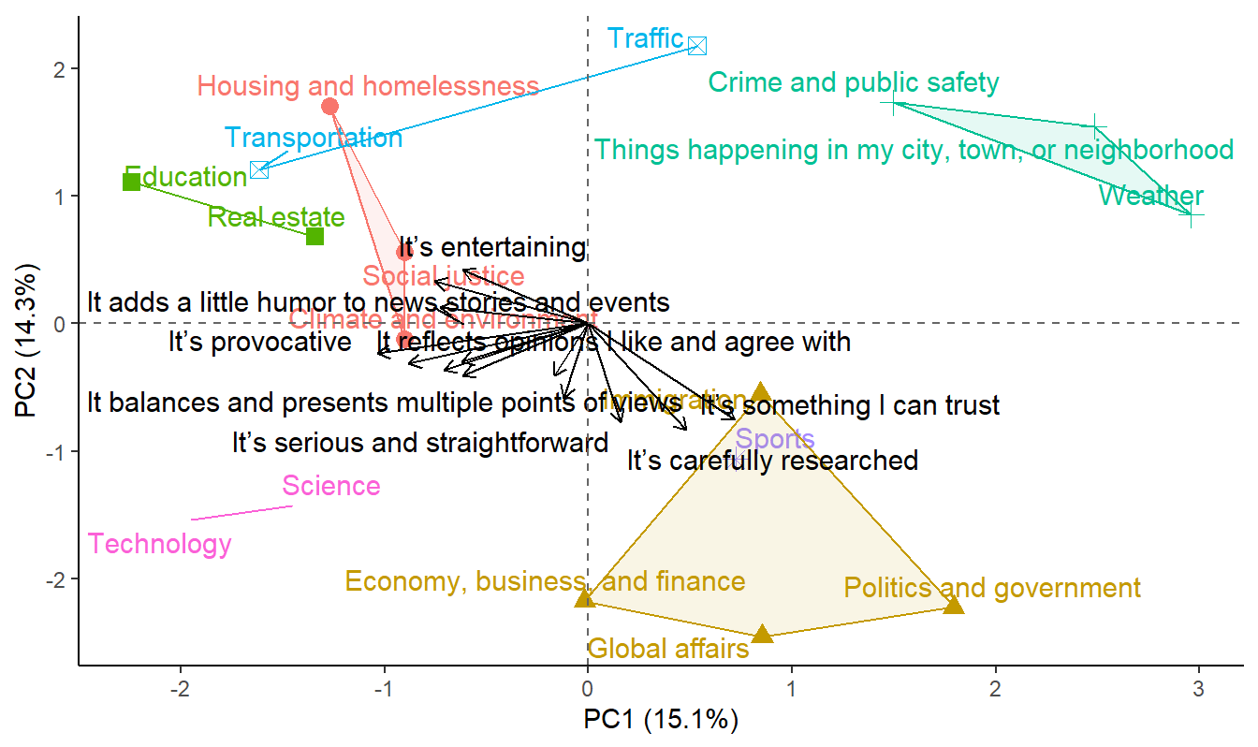
Topics x Characteristics
‹#›
Local Scale
Broad/Systemic Issues
Civic Immediacy
Current Events
Large Scale

Slide 30
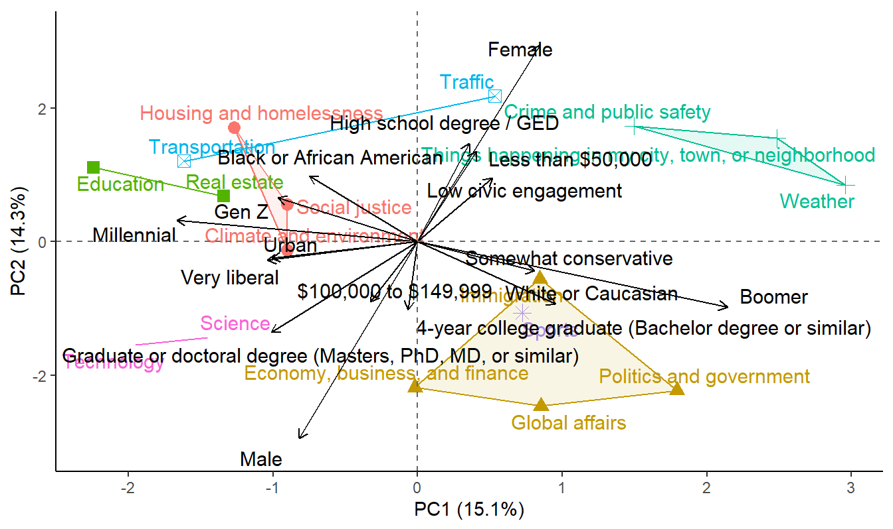
Topics x Demographics
‹#›
Local Scale
Broad/Systemic Issues
Civic Immediacy
Current Events
Large Scale

Slide 31
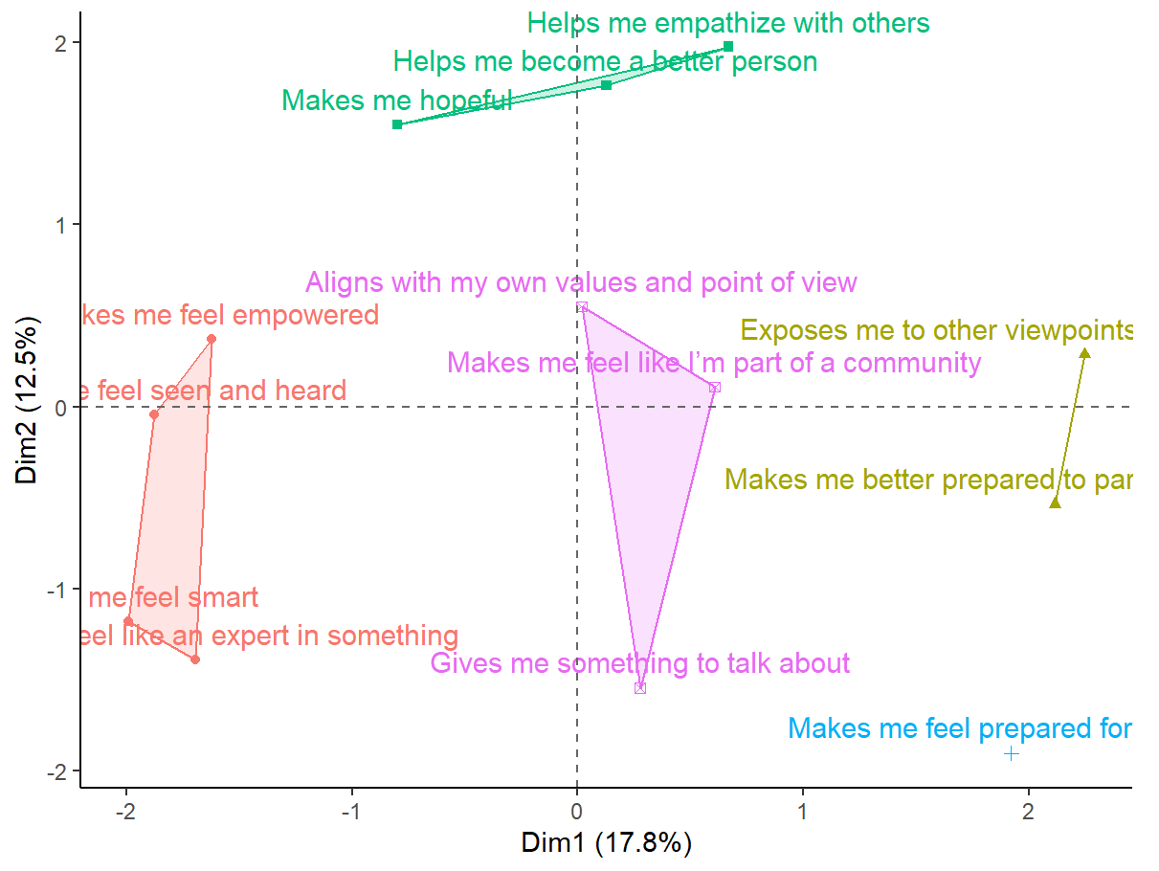
Gratifications
‹#›
Affective/Moral
Self-Enhancement/Affirming
Civic/Altruistic
Cognitive/Pragmatic

Slide 32
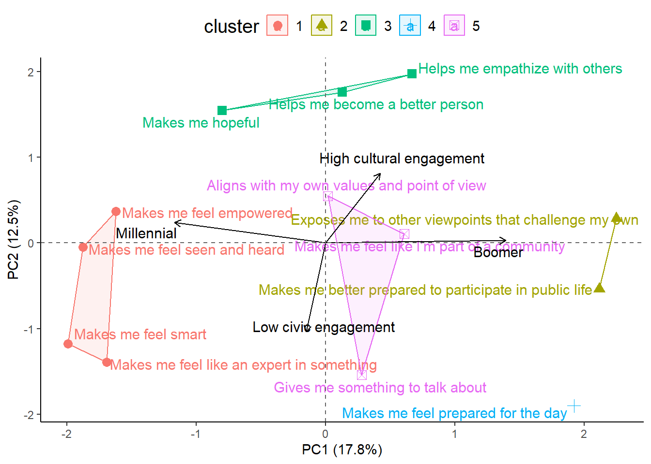
Gratifications X Demos
‹#›
Affective/Moral
Self-Enhancement/Affirming
Civic/Altruistic
Cognitive/Pragmatic

Slide 33
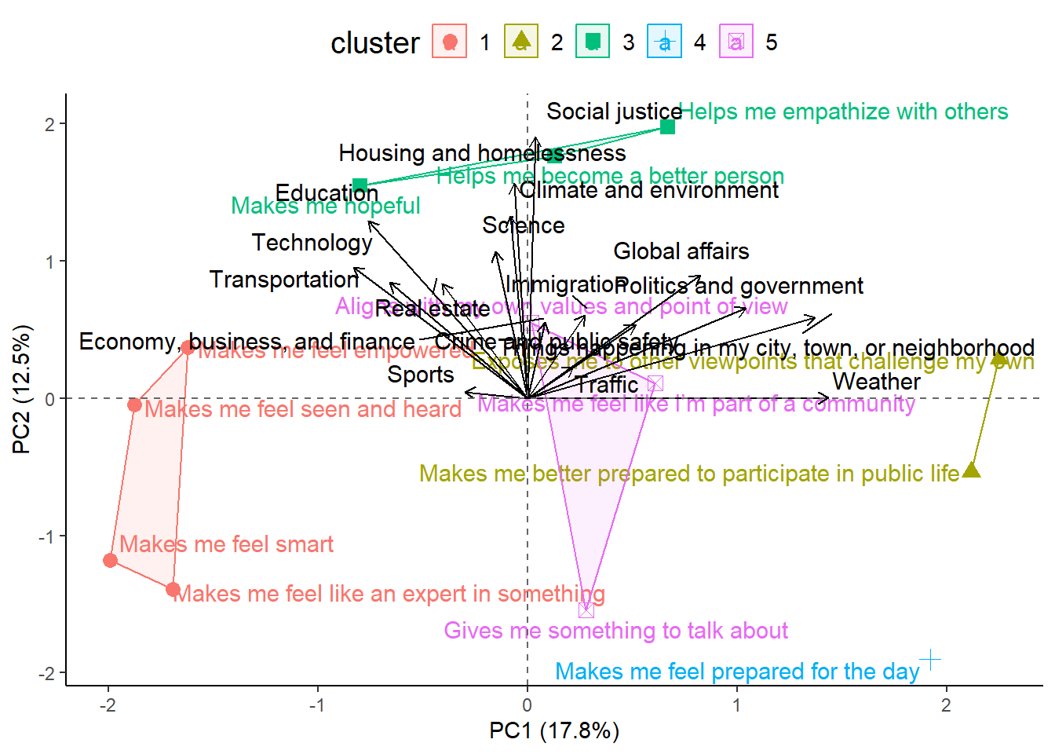
Gratifications X Topics
‹#›
Affective/Moral
Self-Enhancement/Affirming
Civic/Altruistic
Cognitive/Pragmatic

Slide 34
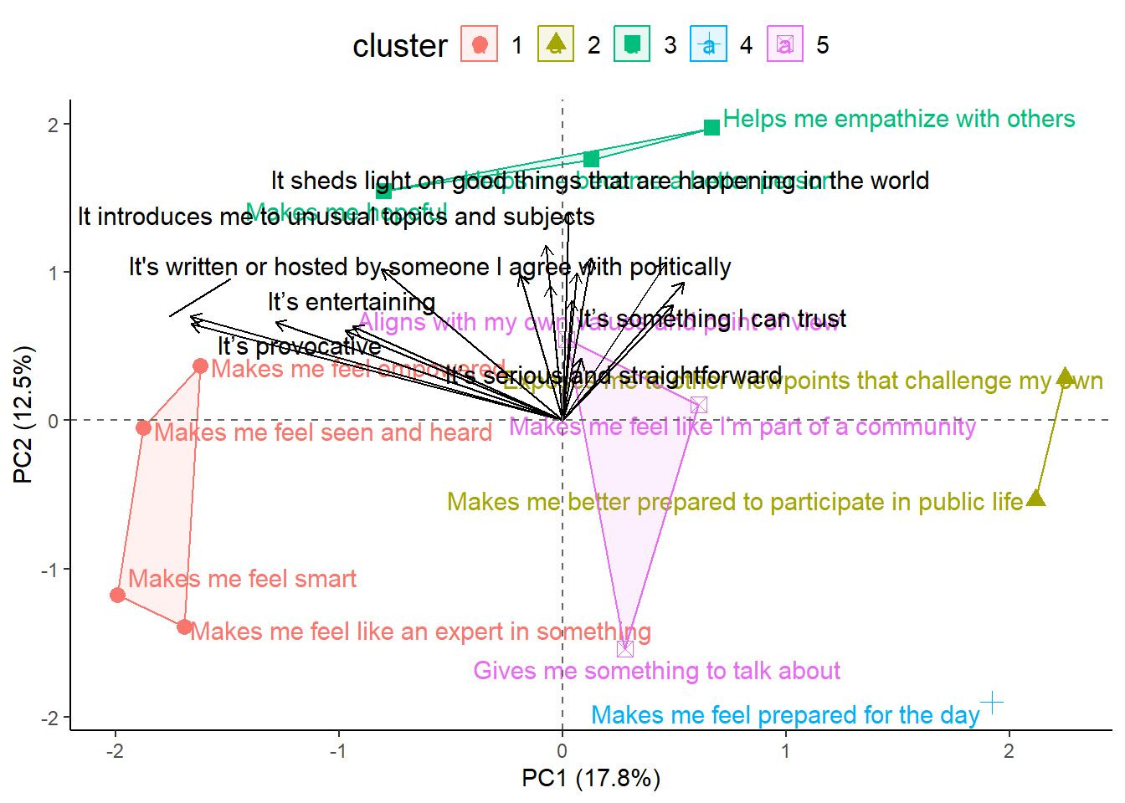
Gratifications X Characteristics
‹#›
Affective/Moral
Self-Enhancement/Affirming
Civic/Altruistic
Cognitive/Pragmatic
Notes:
Most qualities people value in news — regardless of type — are understood as emotionally or morally meaningful, rather than merely utilitarian.
But within that moral space, there’s a split between:
Civic-integrity qualities (research, balance, trust, multiple perspectives), and
Self-affirming / affective qualities (entertaining, provocative, partisan).

Slide 35
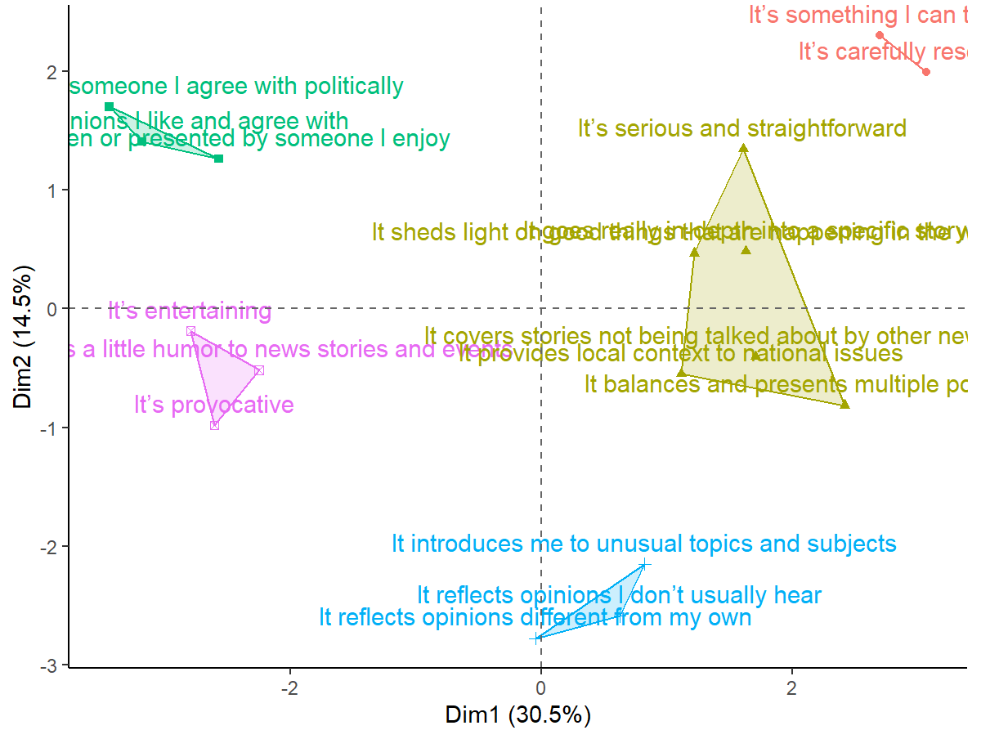
Characteristics x Demos
‹#›
Familiar/Comforting
Personality
Entertainment
Credibility
Challenging/Novel

Slide 36
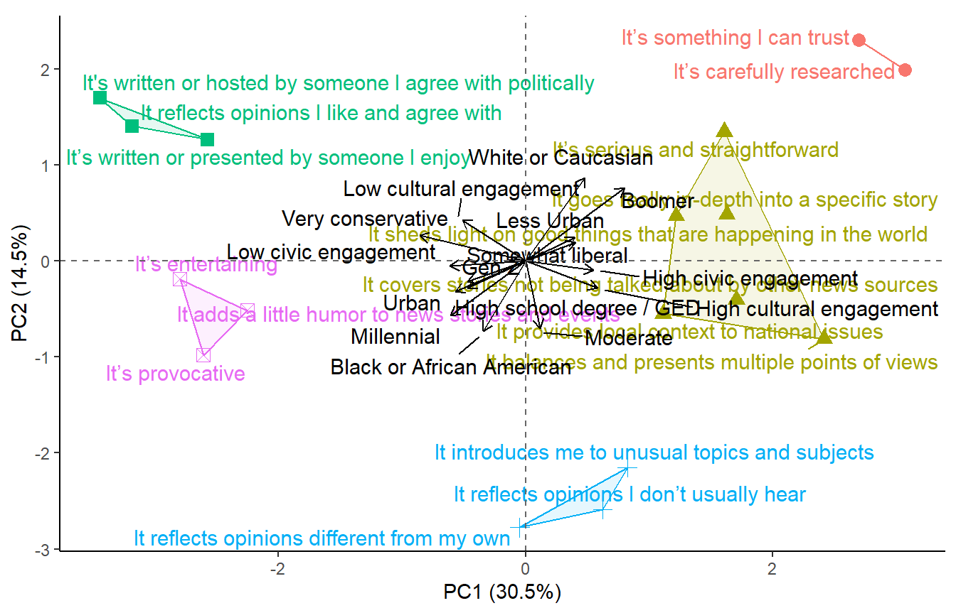
Characteristics x Demos
‹#›
Familiar/Comforting
Personality
Entertainment
Credibility
Challenging/Novel

Slide 37
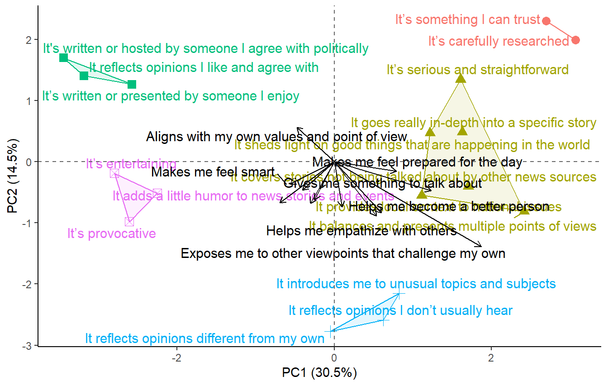
Characteristics x Gratifications
‹#›
Familiar/Comforting
Personality
Entertainment
Credibility
Challenging/Novel

Slide 38
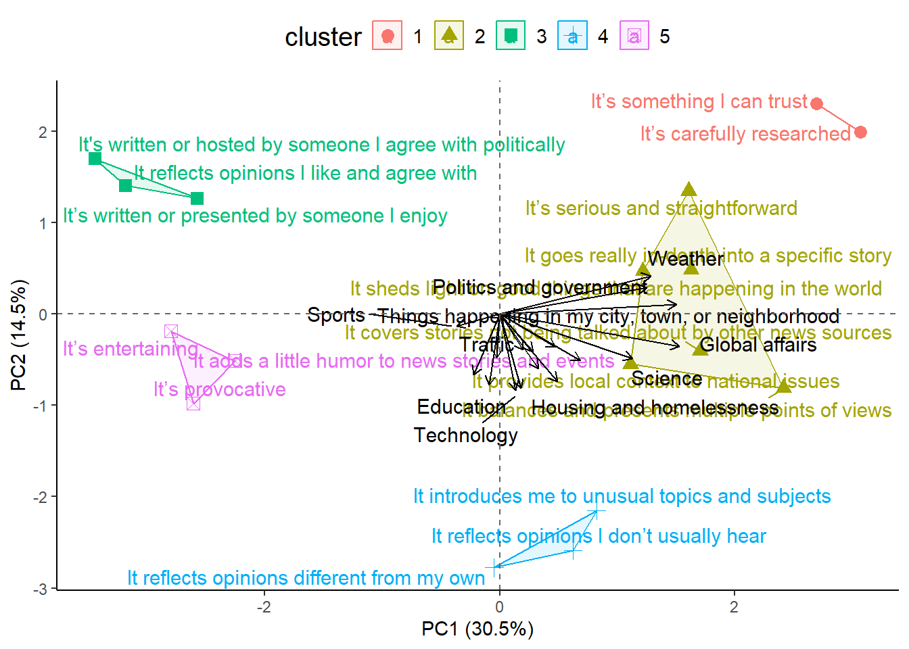
Characteristics x Topics
‹#›
Familiar/Comforting
Personality
Entertainment
Credibility
Challenging/Novel

Slide 39
11/XX/2025
Joel Martinez
Segmentation
Part 2

Slide 40
Problem:
Which arrows are signal vs. noise?

Slide 41
Comparisons
1.
2.
3.
4.
5.
Correlation test p values
Regression p values
Bootstrap stability
Permutation test
Vector Length Threshold
6-ish.
Dual PCA

Slide 42
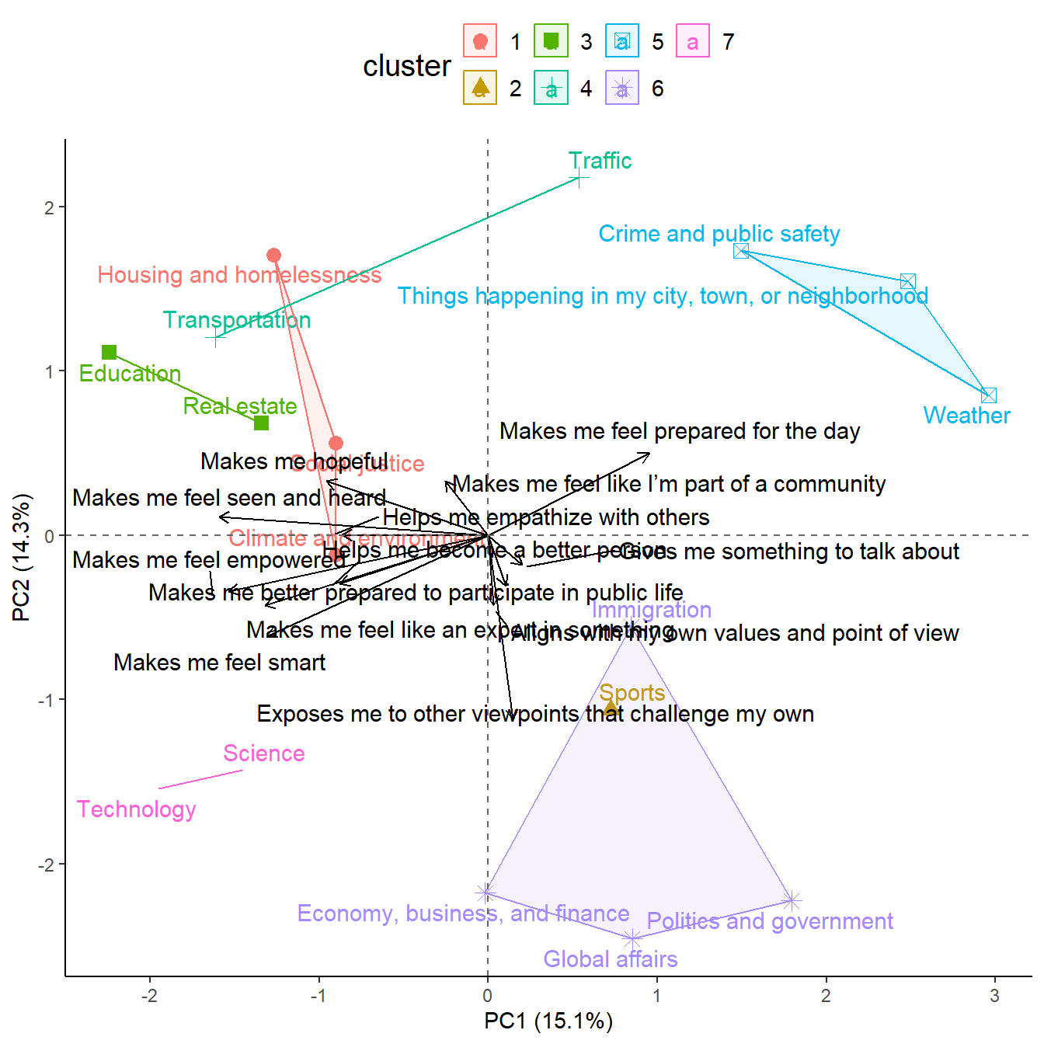
Dataset: Genre Preferences
News topics (clusters) x Gratifications (arrows)
Easy to understand news topic space + only 13 arrows
Goal: can any of the arrow filtering methods reduce the arrows to only show the most significant?

Slide 43
Correlation p value
‹#›
PC2
(x, y)
(r_{PC1}, r_{PC2})
Pro:
fast and easy to implement
Con:
ignores multivariate relations (between variables and PC1/PC2)
issues with p values (e.g., large samples can result in significant p values for very small correlations)
PC1
(r_{PC1}, r_{PC2})

Slide 44
‹#›
Original, no filtering
With filtering (removed 0 arrows)

Slide 45
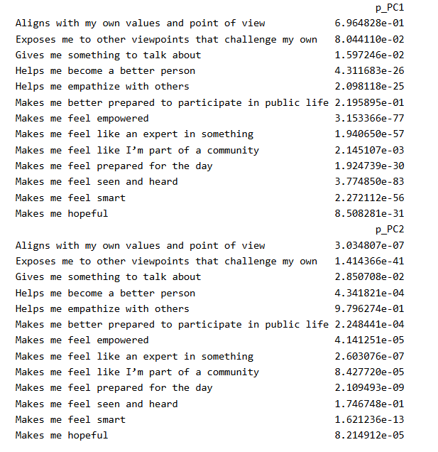
‹#›

Slide 46
Regression p value
‹#›
PC2
A ~ PC1 +PC2
Pro:
Accounts for multivariate relations
Con:
Same issues with p values (e.g., large samples can result in significant p values for very small relationships)
Direction of regression is arbitrary (can’t make causal claims)
PC1
B ~ PC1 +PC2

Slide 47
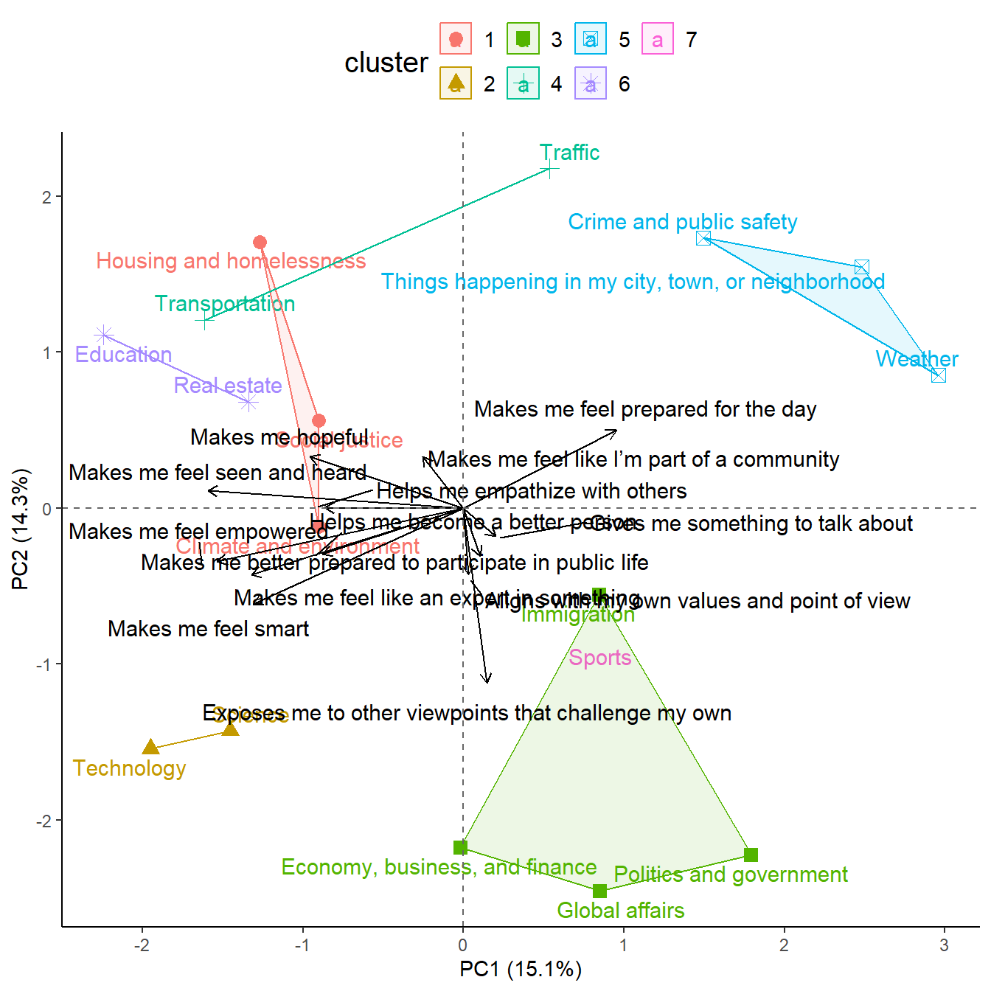
‹#›
Original, no filtering
With filtering (removed 0 arrows)

Slide 48
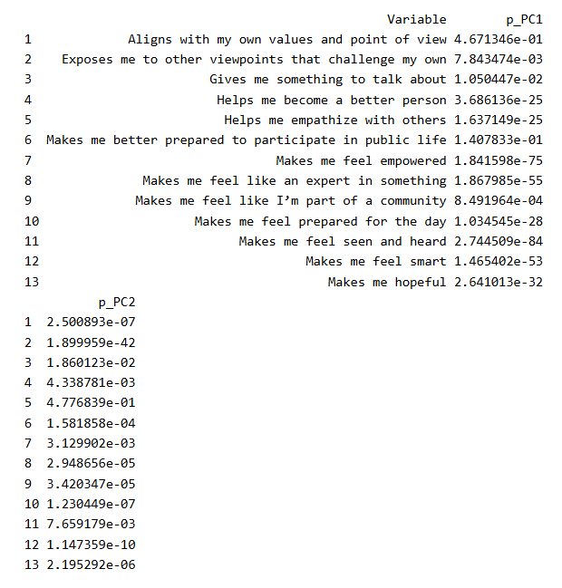
‹#›

Slide 49
Bootstrap Stability
‹#›
Person | Sports | Politics | WEather
A | 0 | 1 | 0
B | 1 | 1 | 1
C | 0 | 1 | 1
Person | Sports | Politics | WEather
A | 0 | 1 | 0
B | 1 | 1 | 1
B | 1 | 1 | 1
Pro:
Measures importance as consistency among subportions of same sample
Con:
Can be slow and computationally intensive (depends on data)
Resample
Replace
x 500+
(r_{PC1}, r_{PC2})
Consistently high magnitude?

Slide 50
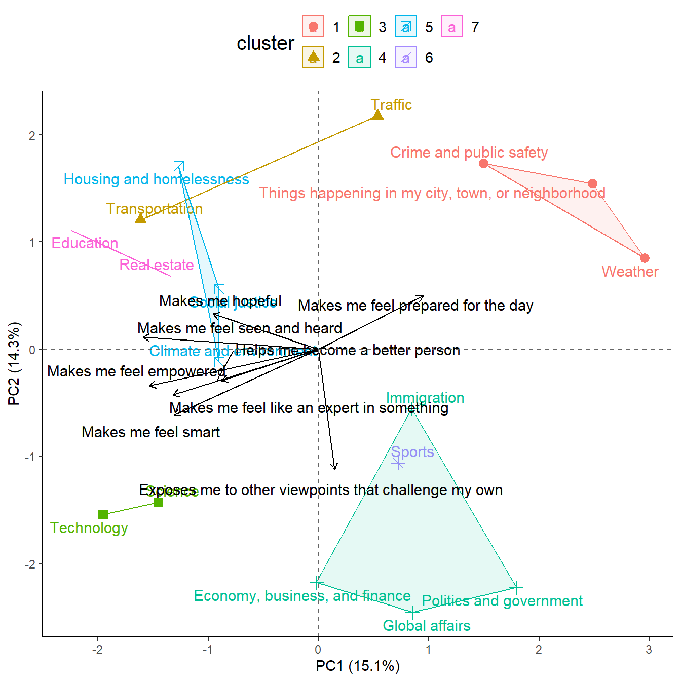
‹#›
Original, no filtering
With filtering (removed 5 arrows)

Slide 51
Permutation test
‹#›
Shuffle x 1000+
(r_{PC1}, r_{PC2})
(r_{PC1}, r_{PC2})
Pro:
Statistical inference
Con:
Can be slow and computationally intensive (depends on data)
Same sample size issue
Person | PC1 | PC2 | Politics | Sports
A | 1 | 1.5 | 1 | 0
B | .5 | 2 | 1 | 1
C | .6 | 0 | 1 | 0

Slide 52
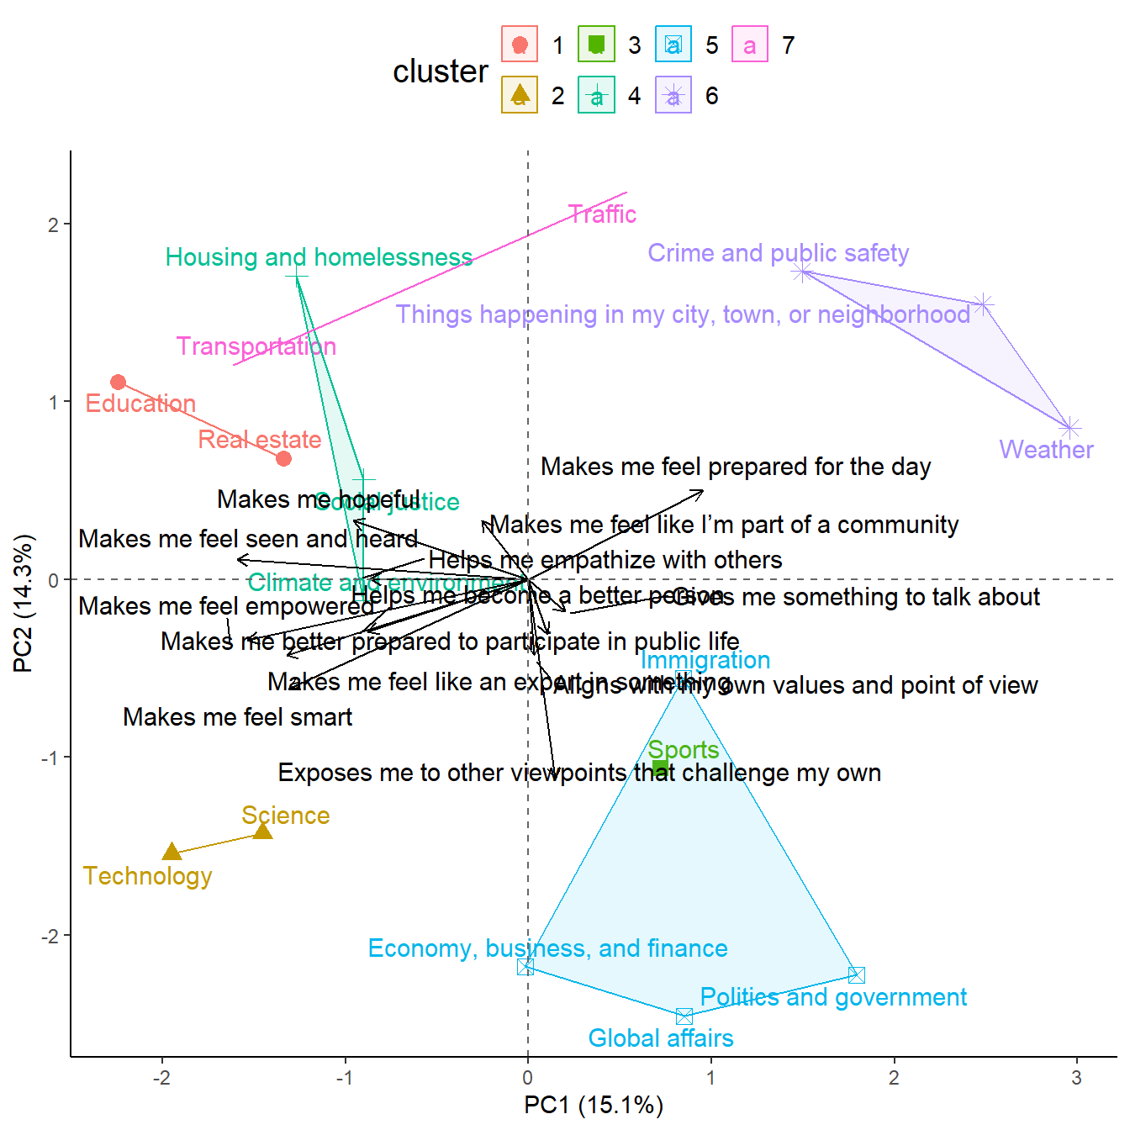
‹#›
Original, no filtering
With filtering (removed 0 arrows)

Slide 53
Vector Length Threshold
‹#›
PC2
Pro:
Simple easy to implement
Con:
Arbitrary, not statistically sound
PC1
Notes:
Keep only variables that have a noticeable combined correlation with the two PCA dimensions — i.e., those that meaningfully align with the underlying structure, not just noise near the center.

Slide 54
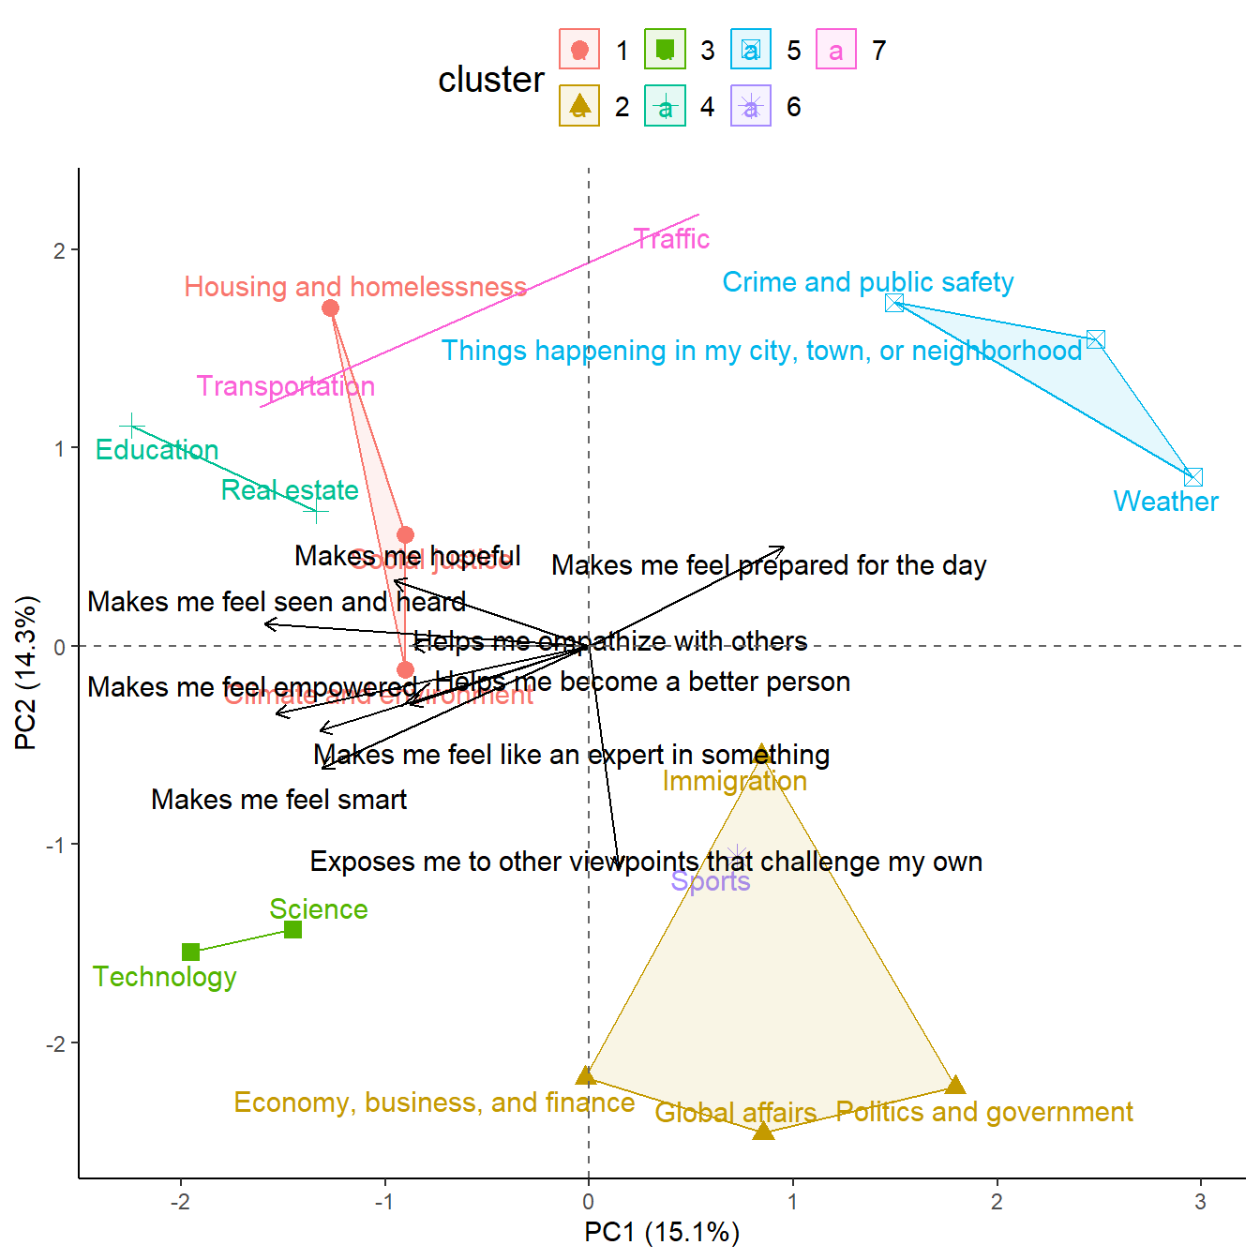
‹#›
Original, no filtering
With filtering (removed 4 arrows)

Slide 55
Dual PCA
‹#›
News Topics
PC2
News Gratifications
PC2
Local Scale
Affective/Moral
NG:PC1
NT:PC1
NG:PC2
NT:PC2
Systemic
Issues
Immediate events
Self
Enhance
PC1
Civic
Relational
PC1
Large Scale
Cognitive/Pragmatic

Slide 56
Dual PCA
‹#›
News Topics
PC2
Local Scale
Pro:
Directly relates more latent/concise summary of relations between different questions
Uses all the data (no need for filtering)
Con:
Results more abstracted from data, harder to communicate to clients
Might over-summarize if individual arrows are nuanced
NG:PC1
NG:PC2
Systemic
Issues
Immediate events
PC1
Large Scale

Slide 57
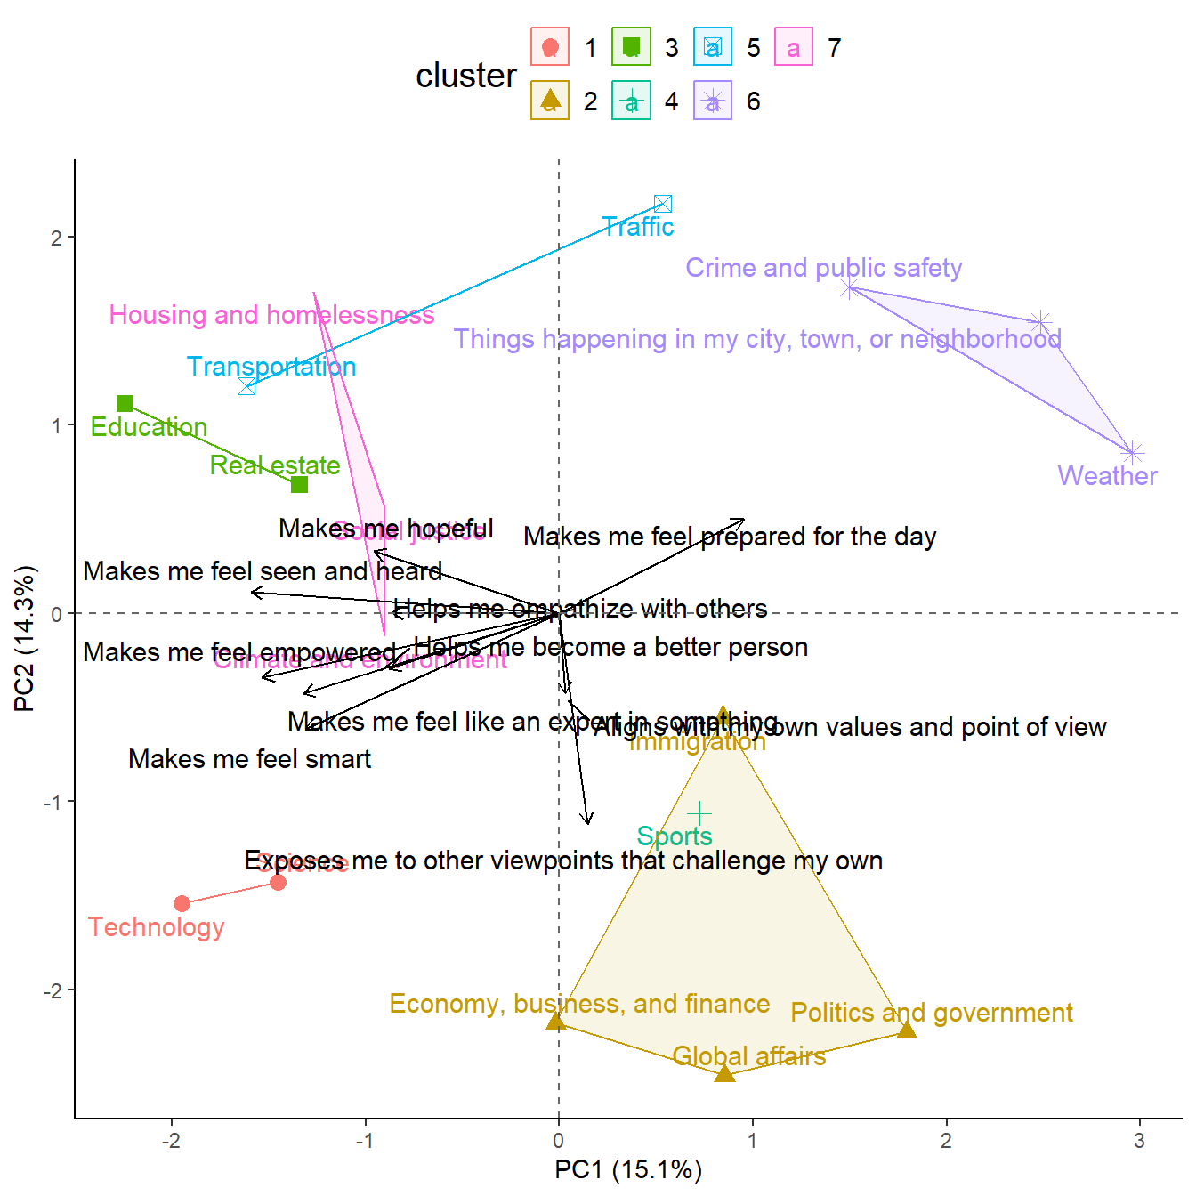
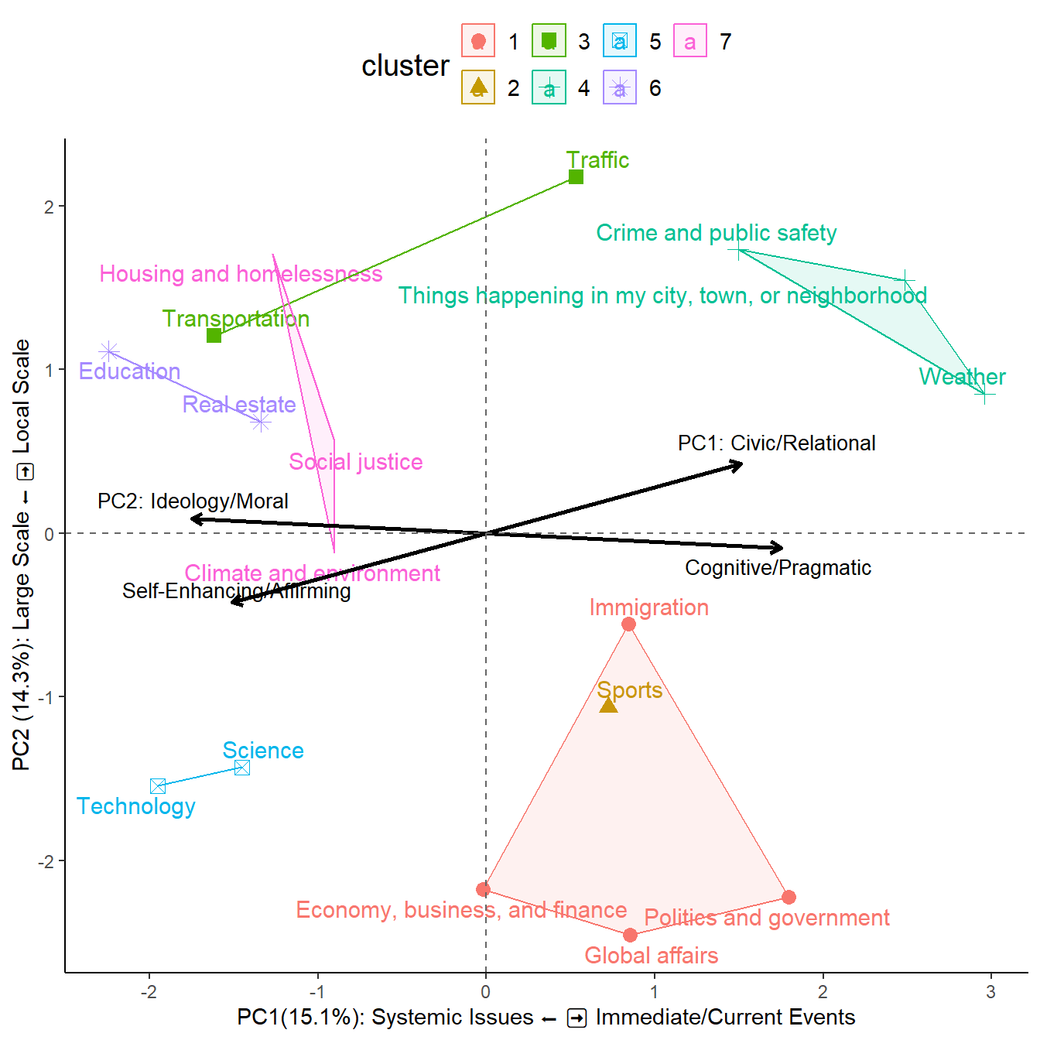
‹#›

Slide 58
Dual Combo PCA
‹#›
News Topics
PC2
News Topics
PC2
Local Scale
Local Scale
NG:PC1
NG:PC2
Systemic
Issues
Immediate events
Systemic
Issues
Immediate events
PC1
PC1
Large Scale
Large Scale

Slide 59
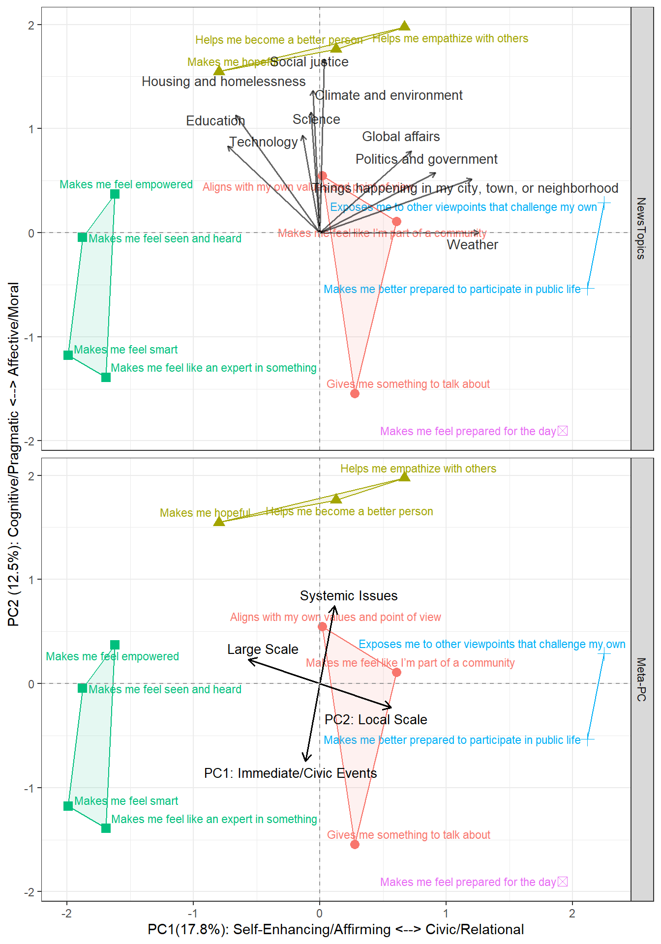
‹#›

Slide 60
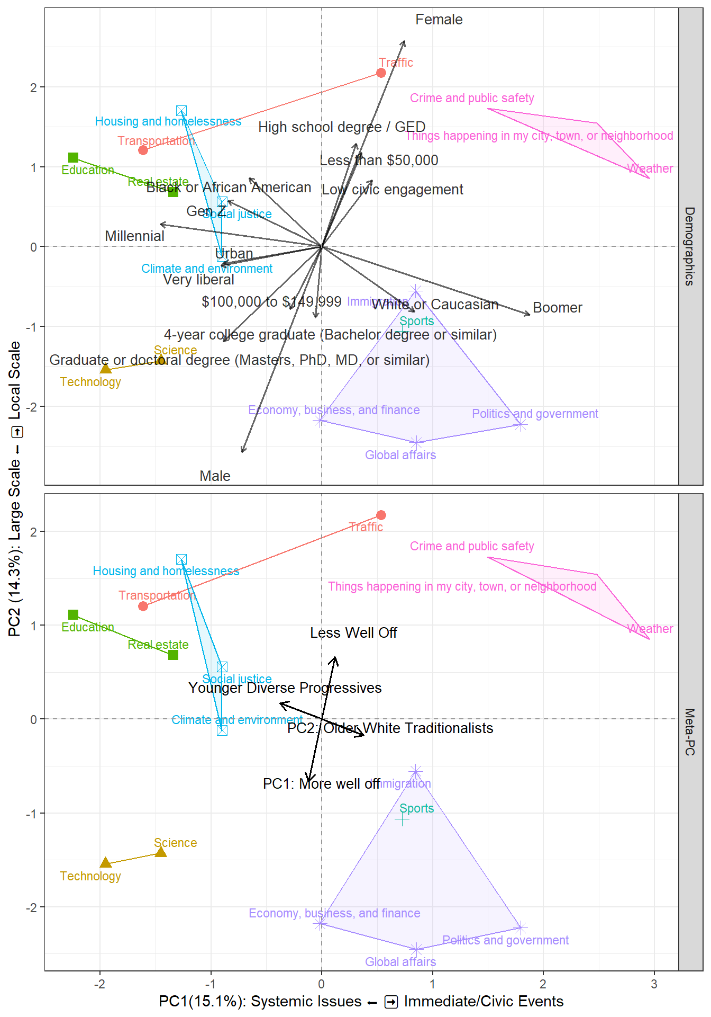
‹#›

Slide 61
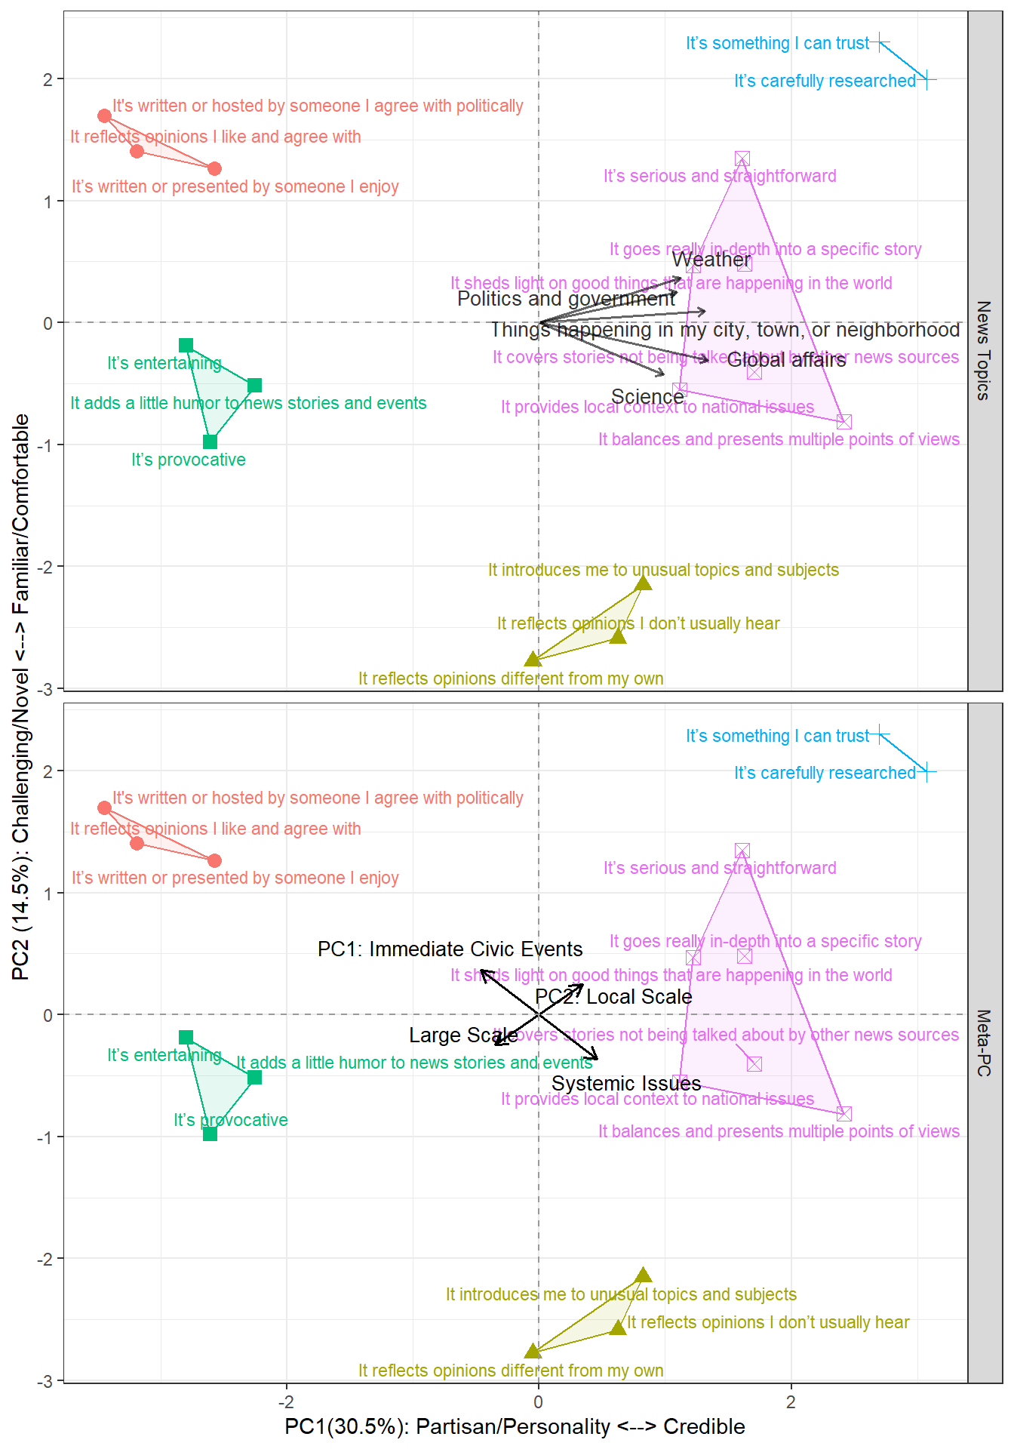
‹#›

Slide 62
Conclusions
Use bootstrap stability to filter individual arrows in biplots
Use dual PCA to help show the latent relationship between two questions
Summary removes the overall noise, but also nuanced patterns in individual arrows
Use dual combo PCA to show both the comprehensive and summarized analysis
Can strategically hide one to show later if asked about it

